Slide 1
Frost Center’s
Future Toward Flourishing
How the Frost Center can support your work at Hope and promote college-wide flourishing

Slide 2
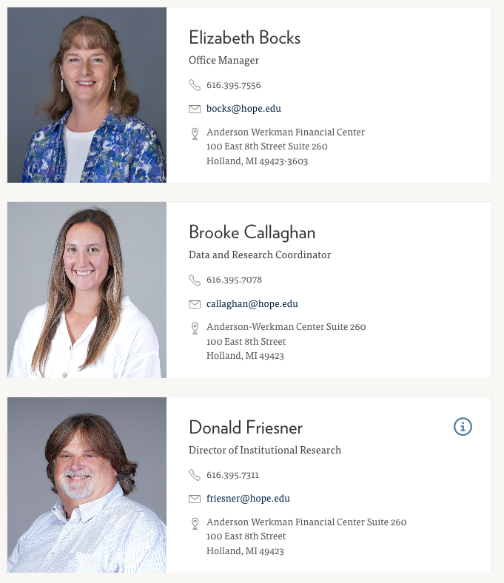
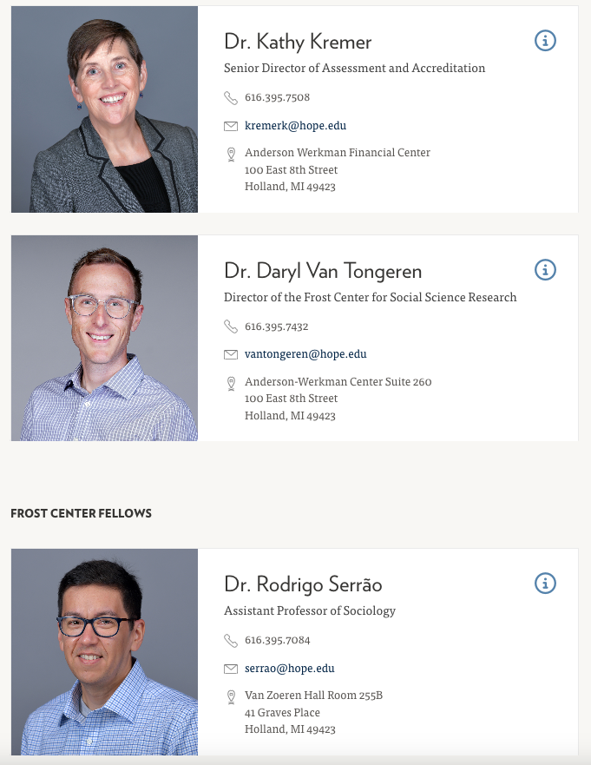
Frost Center Team

Slide 3
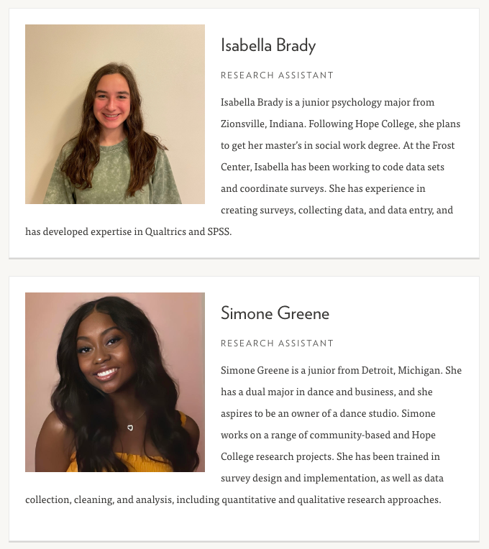
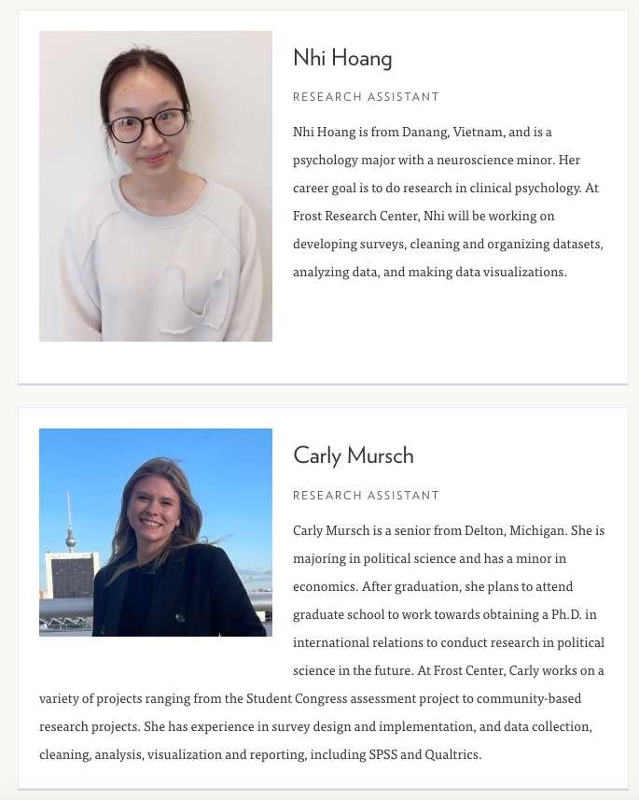
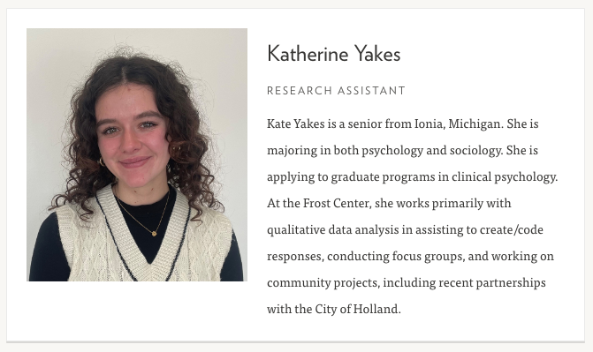
Frost Center Team

Slide 4
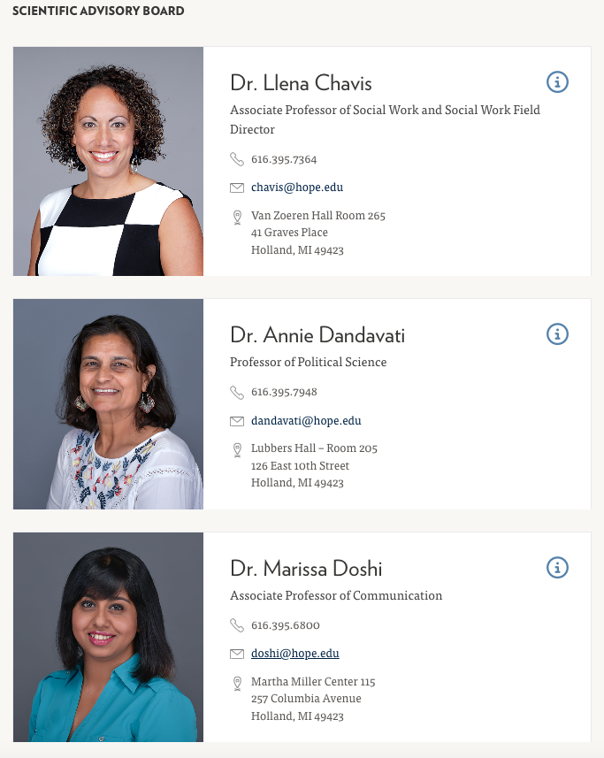
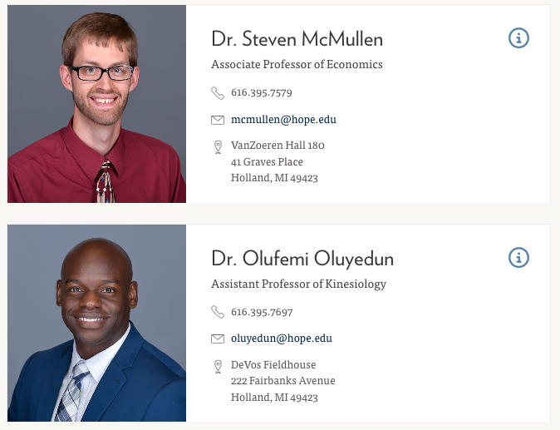
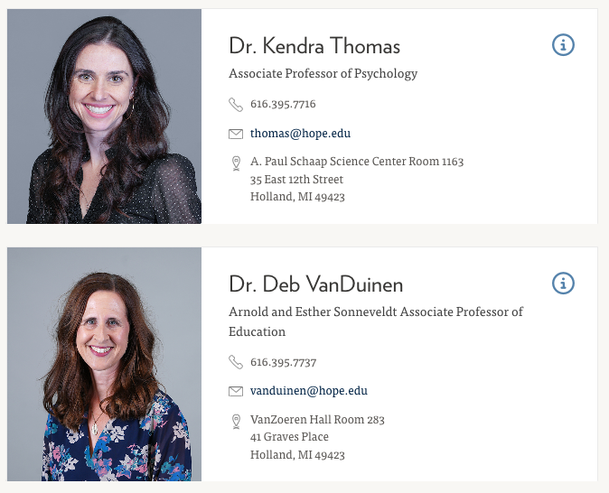
Scientific Advisory Board

Slide 5
Frost Center Structure / Functions
Frost Center for Social Science Research (Daryl Van Tongeren)
Community-based research
Internal research support and faculty development
Institutional Research (Don Friesner)
Data Analysis and Reporting
Data Governance
College-wide surveys
Assessment and Accreditation (Kathy Kremer / TBD)
Ongoing assessment efforts
Regular accreditation requirements

Slide 6
Institutional Research
What We Do, and How We Can Help You
Donald Friesner, Director of Institutional Research

Slide 7
What is Institutional Research?
Identify Information Needs
Collect, Analyze, Interpret, and Report Data and Information
Plan and Evaluate
Serve as a Steward of Data and Information
Educate Information Producers, Users, and Consumers

Slide 8
Two Types of Data
Frozen | Live
Official Census Data of the College | Transactional Data
Strategic Reporting | Operational Reporting
Ability to Analyze Trends (Static Information) | Continuously Changing Information
Used for Official Reporting | Not Used for Official Reporting
Common Uses: | Common Uses:
IPEDS, Common Data Set | Admissions Reporting,
Accreditation Reports, Trend Reporting | Financial/Accounts
External Publishing Surveys | Receivable Reports, Current
Assessment Reports, etc. | Course Enrollments, etc.

Slide 9
Why “Your (meaning mine) Report is Wrong”
Sometimes it is wrong
Mistakes are made in writing queries, or typos.
Banner has errors or incomplete data (being corrected)
Misunderstandings
Institutional Research uses mostly Census (or frozen) Data
Why? Accuracy and Consistency across reporting.
Matches IPEDS and other reporting
B-Lite: Live (or Transactional data)
Why? What is happening today?
Live and Frozen data will rarely match. Majors and minors, enrollment numbers, etc. are fluid and can change daily. Whereas, IR reports as of Census (most of the time).

Slide 10
Other Reasons for Discrepancies in Data
Timing
Definitions
Unclear Data Requests
Example: “I need all faculty emails for a survey”
My first thoughts…are all faculty eligible? Adjunct?
Importance of definitions and detail.
To that end – A Data Dictionary
https://hope.edu/offices/frost-research-center/institutional-research/data-dictionary.html

Slide 11
How can you help?
Plan accordingly
Give at least two weeks for data requests.
Be clear and specific about the data you want. What demographics, what majors (not just “all majors in my department”), What students, faculty, etc. The more clear and defined, the faster a request can be completed.
Understand that not all data is in Banner. It may take awhile to collect.
Think about your request, ask for everything at the same time.

Slide 12
Surveys and Focus Groups
“Anyone can write a survey”. True, but not anyone can write a good survey.
Surveys are research, and should be approached as such.
Research question
Hope College, like most other Higher Ed Institutions, seeks to limit surveys to no more than two per semester to any population or three in total per semester.
Survey Fatigue
Actionable Results
Institutional Assessments

Slide 13
Hope College Survey Policy
https://hope.edu/offices/frost-research-center/institutional-research/surveys/
Survey Schedule
Plan well in advance (not a month, but much further in advance)
Research involving human subjects requires HSRB approval, before the survey will be approved by IR.

Slide 14
How can you help?
Please include Frost Center, and particularly IR early in the planning stage.
Limits frustration later
We can help with formulating questions, how to administer, and timing.
Unapproved surveys can result in losing Qualtrics access.
Does the data already exist? Ask me.
Finally…please consider responding to Hope College surveys. They are important to assessment, planning, and the over-all Hope College community. The higher the response rate, the better the actionable data.

Slide 15
New Initiatives at Frost
Hope Forward Evaluation
Revised Frost Center Fellowship (focus on grants)
RANCH Groups
Faculty research development and support
Working with OSRP

Slide 16
Questions and Answers
What questions do you have?
How can we help you flourish at Hope?

