Slide 1
Assessment Reports
A Brief Guide
May 20, 2024

Slide 2
New reporting form effective May 2024
Link to the report form found in three locations:
in.hope.edu/assessment
Link in the Resources section of in.hope.edu
Action button at hope.edu/assessment
Submitted reports also found at in.hope.edu/assessment
Benefits of moving from Qualtrics to WordPress
Username and password are no longer needed
Ability to save in-progress assessment reports
Operates similar to Hope’s Minutes & Agendas pages

Slide 3
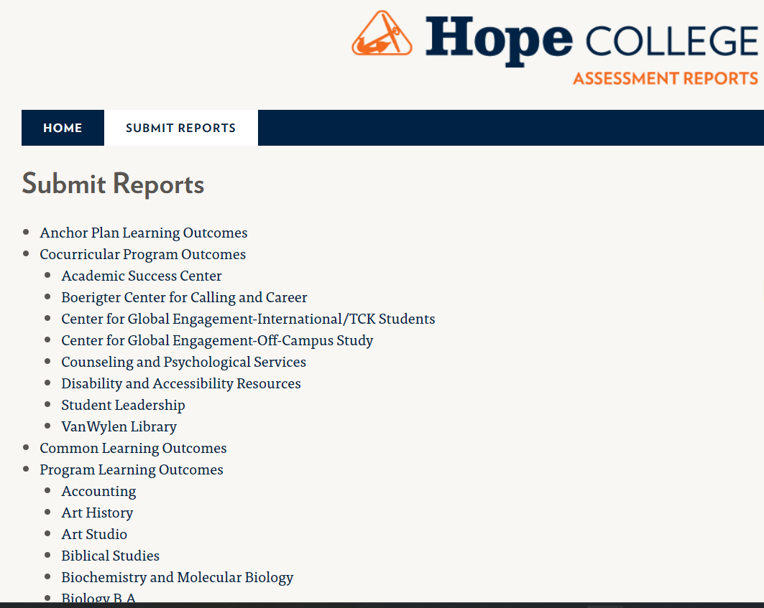
Begin at in.hope.edu/assessment
Select the “submit reports” tab and then select your program from the list.

Slide 4
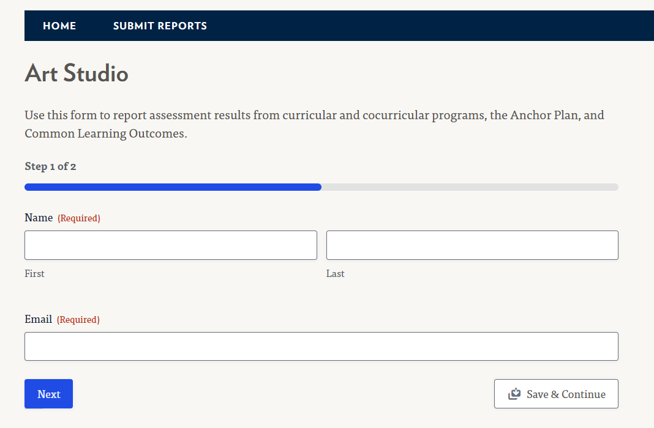
Enter your name and email address, and select “Next”
or
“Save & Continue” if you want to finish later

Slide 5
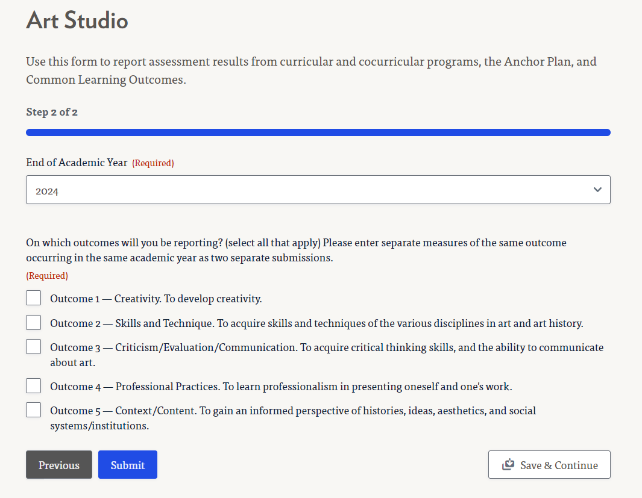
From the drop-down menu at the top of the form, select the end of the academic year of this assessment
Click on one or more student learning outcomes for which you are reporting
Use these tools to go forward, back, or save for later

Slide 6
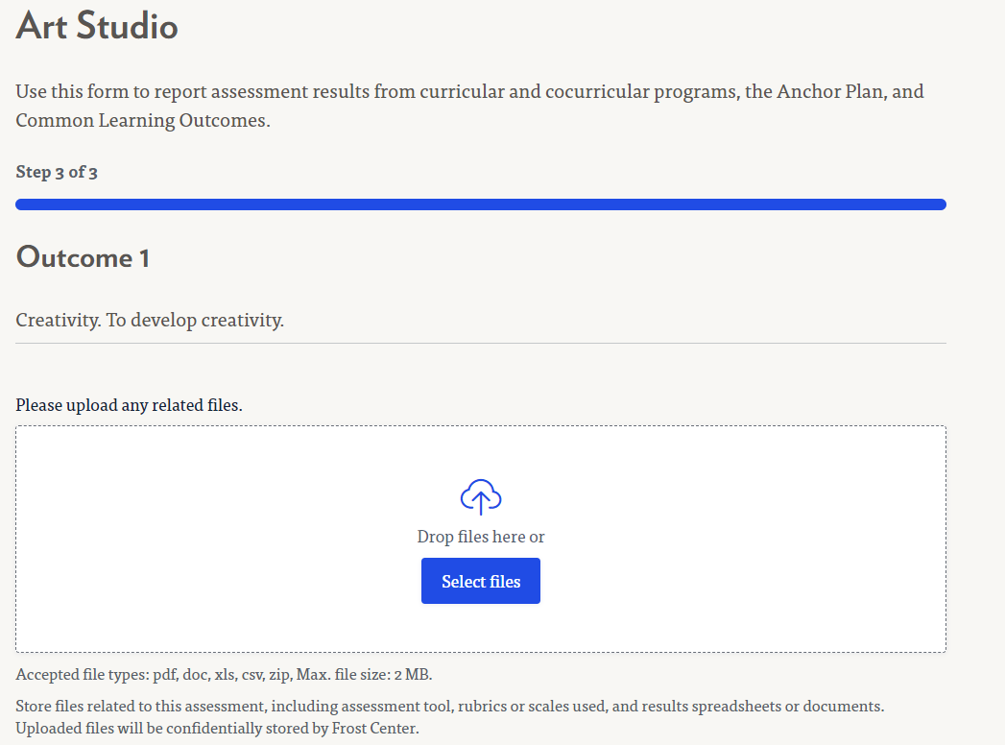
Upload files from this assessment – see list of possibilities (optional)
File types other than those listed should be uploaded as a PDF
Files will not be shared. They will be stored by Frost Center for your future use

Slide 7
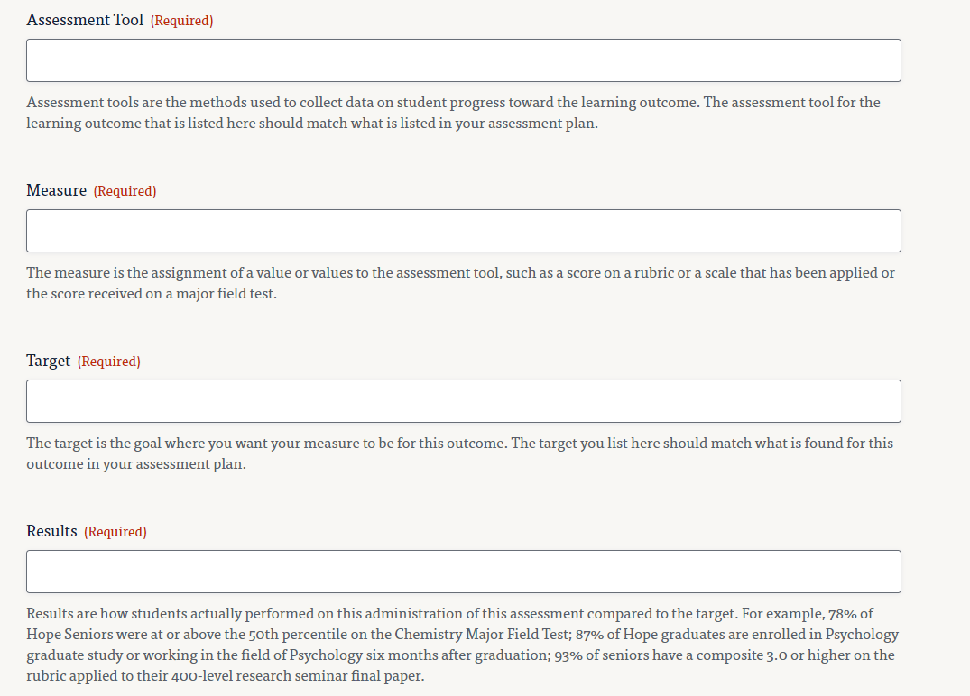
Include brief responses in these text boxes. The Tool, Measure, and Target should match your assessment plan.
Tip: See the instructions below each box for helpful guidance

Slide 8
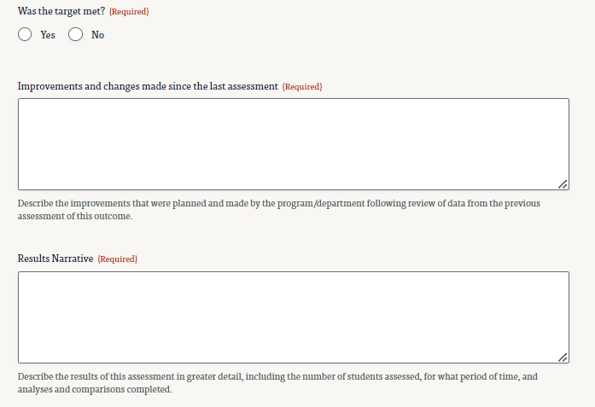
It’s ok if the target wasn’t met. Describe why in the Results Narrative box.
What have you done since this outcome was last measured?
Provide a detailed discussion of your results – this is your results analysis

Slide 9
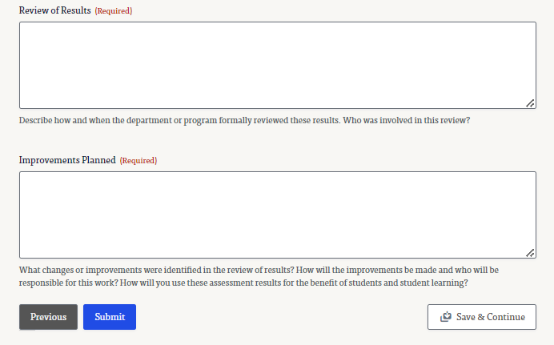
Describe who and when these results were reviewed
Identify improvements you will make for the benefit of student learning

Slide 10
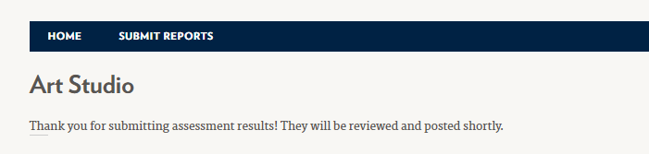
At the bottom of the report page, select “Previous” to go back; “Submit” to go to the next outcome or submit the completed report;
“Save & Continue” to save for future editing
Submitted reports are reviewed by the Director of Assessment & Accreditation and published at in.hope.edu/assessment

Slide 11
Thank you for submitting your assessment reports and making improvements for the benefit of our students!

