Slide 1
Reinvigorating Your Research Program
Frost Center Workshop
November 19, 2025
Daryl Van Tongeren
Director, Frost Center for Social Science Research

Slide 2
Check-in: Hoping to discuss
What are you hoping to discuss today?

Slide 3
Check-in: Your barriers to research
What are some common barriers you’re finding to your research?
Why are you stuck?

Slide 4

Building Productivity in 10 habits
There are lots of ways to ignite a successful research program
And ”success” can mean a lot of different things
Let’s examine some habits that might help you develop consistency and make sustained progress
Published by APA Books

Slide 5
1. Schedule research time and protect it
Research and writing take time, and they are both important parts of this job
You schedule your teaching and would never schedule another appointment during that time; do you schedule your writing and protect that as well?
The power of Writing Time
  Start small but consistent
  Always do something to move your research forward during this time
  Protect this time
Check out Paul Silvia’s book “How to Write A Lot”

Slide 6
2. Think about “filling your pipeline”
1
HSRB (IRB)
2
Data collection (running a study)
3
Data analysis
4
Manuscript writing / circulating
5
Manuscript under review
6
Manuscript in press

Slide 7
3. Be an exemplary collaborator
Be the collaborator you always dreamed others would be
Prioritize turning around papers/projects quickly (norms differ, but my research collaborators and I aim for 48 hours)
Offer something special (e.g., unique participant sample, data analytic techniques, methodological expertise)
Network, network, network (especially at conferences)…then be ready to carry the lion’s share of the load in the beginning as you demonstrate value of collaboration to others

Slide 8
4. Establish an effective writing process
Be clear on authorship early on
Clarify what everyone’s roles on the project are; first author does the heavy lifting
Circulate paper among coauthors and instruct them to:
  Make changes directly to paper (NOT COMMENTS, except for analyses)
  Move the paper along quickly (48-72 hours) or they’ll be skipped and circled back
  CC the entire team as papers move forward so the rest of the team can see the progress
First author submits, shepherds through editorial process, and usually takes care of RR requests

Slide 9
5. Involve students
Think about how to involve students at every stage of the research process
Good research mentorship = good teaching
It’s more rewarding to collaborate with energetic students, and they often teach us, too
A graduate-style lab setting

Slide 10
6. Develop a habit of seeking funding
Utilize internal grant mechanisms at Hope
  Character Forward Grants ($15,000 each year)
  Nyenhuis grants in the summer (many kinds; annual; summer support)
  Frost Center Fellowships (annual; year-long fellowship)
  Towsley Research Scholar Fellowship (third-year; four-year fellowship)
  Departmental support
Use those pilot funds to write external grants
  OSRP is terrific
  Start small and then build up

Slide 11
7. Nothing for a single purpose
A grant proposal can be a literature review introduction
A student’s poster can be translated into a coauthored manuscript
Readings for class can enhance your inquiry in a new area of scholarship
How can you integrate your research and teaching more seamlessly?

Slide 12
8. Embrace rejection
Get used to rejection (we don’t have “batting averages”)
You never get the pellet if you don’t press the bar (successful folks don’t avoid rejection; they persist despite it)
Your work will be rejected a lot. My work has been rejected a lot (e.g., my graduate school drought)
Journal rejection rates in social psychology are 90-95%. Grant rejection rates can be 90-95% (or closer to 98-99% now)
Don’t let rejection stop you; allow it to motivate you

Slide 13
9. Set goals
Start (and regularly refer to) a document with your
  short-term goals (e.g., this year, next year)
  mid-range goals (e.g., pre-tenure, next 5 years)
  long-term goals (e.g., 10-15 years)
  lifetime goals (e.g., before you call it quits)
Make them SMART: Specific, Measureable, Attainable, Realistic, and based on a Timeline
Break them into smaller sub-goals (e.g., collecting Sample A this semester; writing the paper by next semester)
Share these with a few trusted confidants (commitment principle); be accountable
Regularly take stock of your progress, adjust if needed, and celebrate successes

Slide 14
10. Have courage (and hope!)
Fear, perfectionism, and procrastination are three of the biggest three to productivity
  Fear that you will be rejected (newsflash: you will) or be thought stupid (reviewers are USUALLY constructive) or aren’t good enough (you have something important to say)
  Perfectionism keeps us from sending things out (submitted is better than unpublished)
  Procrastination stall us out indefinitely and can be dealt with by scheduling and holding your self accountable
Do it, even when you don’t want to (in the moment)
Swing for the fences…you can always work your way down the publication or grants ladder
We learn from rejection, and we usually get better

Slide 15
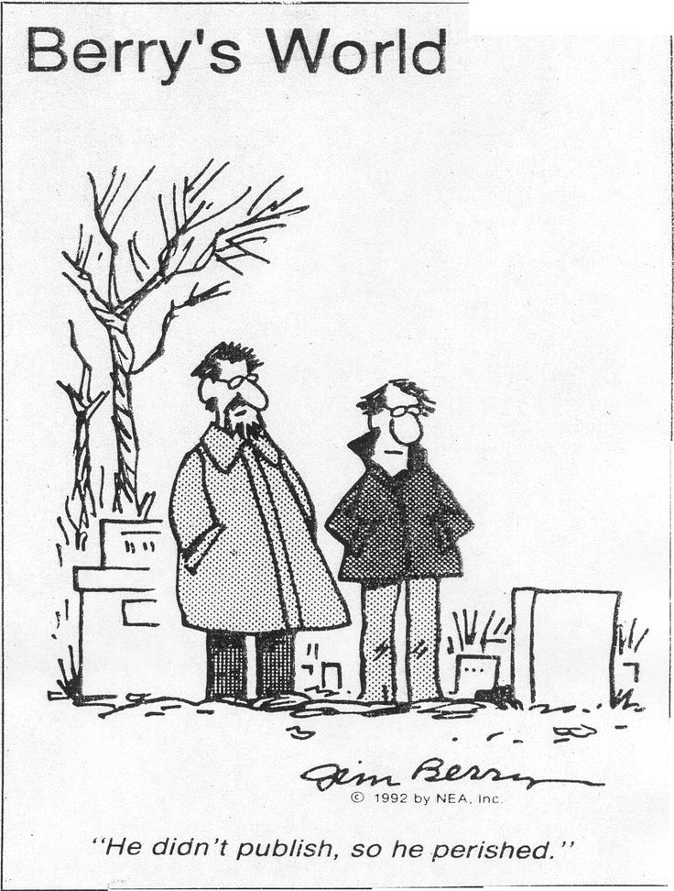
Publishing
Different kinds of publications
  Peer-reviewed journal articles
  Chapters in edited volumes
  Edited books/volumes
  Authored books
  Popular press
Most of our barriers are psychological (and some are practical)
Consistent contributions are possible

Slide 16
Publishing
Identify your personal goals:
  What do you want in this aspect of your career?
  What can you uniquely contribute or say?
Consider your opportunities:
  What outlets are best for your work?
Develop a system that addresses the fear
  It’s just work. Honestly. Not an indication of your worth or value.
  Log the time and make progress

Slide 17
Publishing
Submit and forget; then, start working on the next one
When you get a decision, deal with R&Rs right away
Send rejects back out quickly (don’t let them end up paper purgatory); fix what you can and move on
An agreeable cover letter is the best kind—the accepted kind
Celebrate your victories and repeat

Slide 18
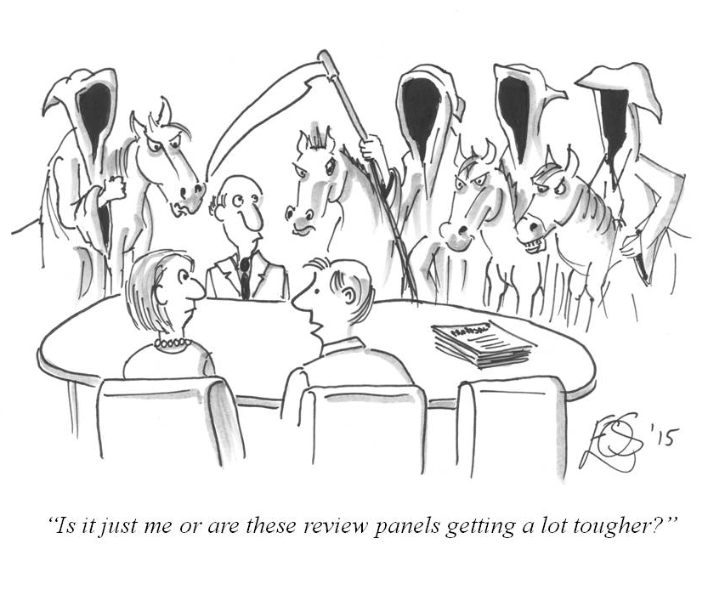
Seeking grants / external funding
Grant proposals are a LOT of work, but they can help clarify your thinking
  Nothing for a single purpose
Most start with LOI stage before Full Proposal
Start thinking early (1-2 years)

Slide 19
Seeking grants / external funding
Find with the right agency (work with OSRP; see previous presentations on the Frost Center website)
Align with donor intent
Tips:
  Why do you need the money?
  Be clear to a distracted review
  Organization is critical
  Practical importance
  Demonstrate your outputs
  OVERDELIVER

Slide 20
Let’s discuss!
What has worked for you in the past?
How can we support one another?
What are tangible steps that you can start implementing now?
How can the Frost Center support you?

