Slide 1
Frost Center Colloquium:
Building your Grant Writing Skills

Slide 2
Agenda
Grant Cycle
Writing Tips and Tricks
Grant Writing Time Management
Navigating Resources
Prospecting
Q&A

Slide 3
The Grant Cycle
Pre-Award
Articulate your Idea
Research Funding
Develop Proposal
Submit Proposal
Award & Acceptance
Post-Award
Project Start & Management
Project Completion
Outcomes and Reporting
Grant Closeout

Slide 4
Writing Tips and Tricks
Review the CFP multiple times
  Diction
  All the information you need!
Write an Abstract
  Getting started is the hardest part; Make it easy!
Writing and Rewriting; Peer Editing
  Mentors, Colleagues, OSRP
  Example Proposals
SAVE YOUR WORK!
Notes:
Review the CFP Multiple Times
Word choice is essential in writing a successful proposal. There are many ways to use a CFP to help you decide how your frame your project proposal! For example, look for recurring words or phrases. These words or phrases are being used by the funder to help you understand their funding priorities, so head that advice. As content experts, PI’s have a tendency to use very technical language in their proposals. Depending on the funder this can be acceptable. For example, if you are applying to a Federal Foundation, like the NSF, for which the proposal is being requresting funds for the purchase of a new piece of technology. You may have to use precise language to identify the need for the technology, explain why this piece of technology is your best option, or describe what work can be achieved with this technology that otherwise would not be accessible. On the other hand, were you applying to a family foundation and the project was focused on funding some sort of research including students, you may want to emphasize more what that experience is going to be, what it can provide the students, where the project aligns with the foundations goals , etc. CFP’s will provide all the information you need to tackle these issues as well! If the CFP uses technical language throughout the entire document, then that is a sign on how to proceed!
Write an Abstract
When you start writing it is important to get the big ideas down on paper. Details will all be worked through during the grant cycle, but it has to start somewhere! Write an abstract, or summary, of your project. Getting something down on paper will help you verbalize your idea, start to think about possibilities for programming, and provide an opportunity for us in the OSRP office to understand what you are looking to accomplish. When you have written the abstract, you will be able to start thinking about who else could be involved in the project. It also flows into our next tip, peer review!
Writing and Rewriting; Peer Editing
Once you have something written, this can be an abstract, a portion of the narrative, or the entire thing, you should start pulling in trusted people to review your work. These trusted people may be colleagues, mentors, us in OSRP, or anyone within your circle who you think could provide unique, and valuable, input. Great ways to determine who these people may be is by looking at their history with grant submissions. Have they written a grant before? If they have, was it Federal or Private? Is it for the same program you are writing for? Are they within your discipline? Do they have technical experience if you are writing a technical proposal? There are so many questions you can ask yourself to determine who might be a good fit for your review process. Another way to approach reviewing is by looking at example proposals! Example proposals are valuable in helping writers determine what foundation review panels are looking for. OSRP has a repository of past Hope College submissions, as well as a network of colleagues at other institutions similar to Hope that may have submitted for the award you are looking to apply for. Example proposals, especially those with reviewer notes, or that have been accepted, can shed light on things the foundation appreciates out of awarded institutions, PI’s or program activities!
Save your work
This last point, even in the age of google docs auto save, is so important. SAVE YOUR WORK! Find a way that works for you, but try to store a backup copy of completed proposals. While you are writing, ensure that you NEVER close out a tab without looking for the save icon, or if you are working on microsoft office, make sure you save the document. This also applies to portals. Some portals will have you write your application in the portal. If you choose to use these portals to write, please ensure that it does in fact save your work. One way to do this is to make sure you read all the instructions, as they will usually tell you how to use save functions. If you are using a portal, it is my recommendation that you write the proposal in a google doc or word document, then transfer the writing over once it is complete. Reviewers and foundations are not looking at your yet to be submitted applications, so don’t worry about making it look like you are progressing through the process.

Slide 5
Grant Writing Time Management
Develop (AND STICK TO) a timeline
  Be realistic in planning
  Allow time for uncontrollable circumstances
Budget Early; Discuss Often
  Contact OSRP (Early Notification Form)
  Start with EVERYTHING, then trim the excess
Draft through an Outline
  Use the CFP (Call for Proposal)
  Lay out a framework and develop as you are able
Set small goals and plan downtime
  Keep your motivation and avoid burnout
Notes:
Develop and stick to a timeline
When planning your proposal, it is generally a good practice to write down a realistic timeline. This can mean a lot of different things depending on how early you start, when the deadline is, and what you need to prepare. There is no one size fits all. General advice, however, would be to be realistic in your planning, allow time for uncontrollable circumstances, and STICK TO YOUR TIMELINE. Being realistic with your planning is important. Make sure that you are allowing yourself to brainstorm, outline, write, rewrite, rewrite again and then share for revisions. You also have to consider time to figure out budgeting, supplementary documentation (like biosketches, letters of support, etc.), and uncontrollable circumstances like maintenance on portals, internet being uncooperative, or, if you are applying for federal funding, circumstances like government shutdowns.
Budget Early; Discuss Often
The catchprase of OSRP is “Early and Often”. Most questions like, “When should I start talking about….” or “When should I get this person involved”, our answer will be “early and often”. It is better to over communicate than not communicate enough. My nickname at my previous institution was “The Polite Pest”, because I would sit at peoples desks, send emails, or catch people in hallways to talk about planning or to get signatures. People may say, “I am not sure right now” or “I don’t have those details yet” and that is ok! Especially when it comes to budgeting, make sure to contact us in OSRP using the Early Notification Form! It is linked on our website, or can be found by googling “Early Notificaiton Form, Hope college”. We can assist with figuring out what you may need for your budget. A good tip when starting to write your budget is to think about everything that costs money for your project and write it down. You don’t have to assign values straight away, and you may not include it all in the budget, but it will help you to determine what you may need. Start with everything and trim the excess.
Draft through an outline
Outlines are a great time management tool. They are great because they allow you to divide your entire narrative into more bite sized pieces. Not only is this helpful to collect your thoughts, it can also be a way to organize your timeline. Setting checkpoints for yourself, where by a certain date you have XYZ section(s) done will help you focus your time. CFP’s often show you a bit of information on how a proposal is organized. Sometimes they even give you the sections they want to see! (Proactive grant CFHZ). Laying out the framework will save you a lot of mental energy as you progress through the project, and help to keep your thoughts organized!
Set small goals and plan downtime
This relates back to the timeline section. Setting small goals can help you keep motivation, and coordinating those goals with downtime can help your brain recover from heavy writing periods. Downtime isn’t necessarily meant to say you are on vacation, but rather that you are shifting your focus momentarily to something other than the document you have been staring at for weeks on end. Even shifting your focus for a day or two can help you to recover that mental stamina and move forward with more energy. Don’t discount the power of serotonin and positive writing practices

Slide 6
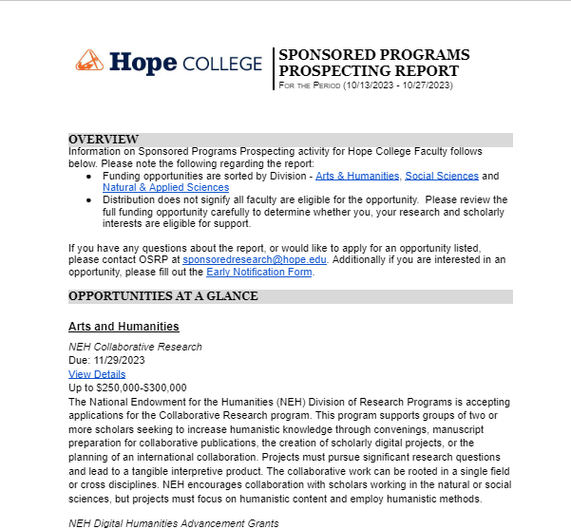
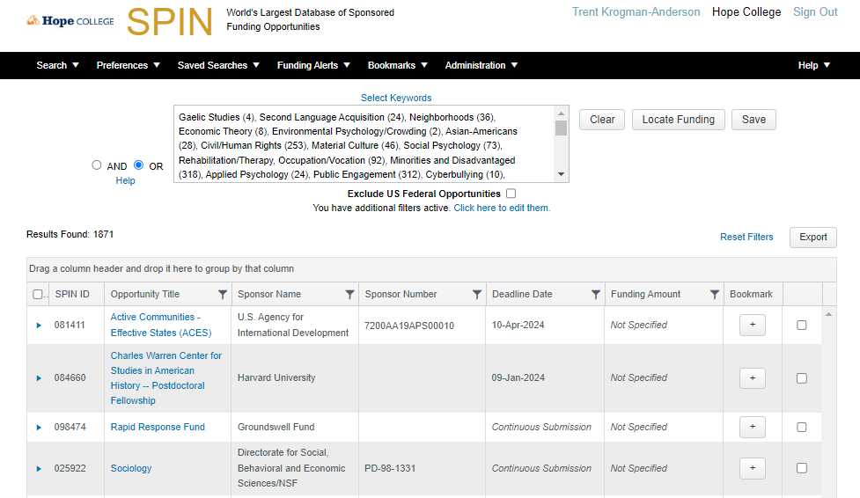
Prospecting
Prospecting report bi-weekly from OSRP
  Next report to be sent out Monday, Nov. 13!
SPIN/SMART
  Training Available
  Research Interest Meetings
Notes:
Prospecting report bi-weekly from OSRP
We have started creating a repository of prospects for interested grant writers. Right now we are sending these out in a ‘report’ format through email. The first report came out last week monday, and the next report will be out this coming monday. The prospecting reports are divided between each of the divisions, and present opportunities that are both federal and private. For each opportunity there is a link to the CFP, a description of the program and broad details including due date and maximum fund amount.
SPIN/SMART
The SPIN SMART system is our institutions prospecting system. We are able to set searches for many topics, save them to profiles and set notifications. The system can be used in a couple of different ways. First, you as a member of the hope College community can have an account set up so you can do independent searches. We are happy to help facilitate training, and prepare you to delve into the wide ocean of information presented here. Secondly, we can set up searches for you on SPIN/SMART. If we were to meet regarding your research interests, generally we cna build a search for you during that meeting and assign it to your profile. Additionally, you can use the system without an account! You won’t be able to save any searches, but it still search the database!

Slide 7

Navigating Resources
OSRP Website Resources
  Each tab will take you through a different part of the process
  Resource Portal
    Hope Login (without @hope.edu)
    Workshops Available
    Samples of Successful Proposals

Slide 8
Questions?
Trent Krogman-Anderson
krogmananaderson@hope.edu
sponsoredresearch@hope.edu
https://hope.edu/offices/sponsored-research-programs/

