Slide 1


Exploring Student Residence Hall Ambiance:
Consequences and Typologies
Presented by:
Benjamin R. Meagher

Slide 2



Introduction
Colleges and universities invest millions of dollars developing and maintaining buildings and common spaces on their campuses

Slide 3



Introduction
Colleges and universities invest millions of dollars developing and maintaining buildings and common spaces on their campuses
At the same time, there is growing concern about the mental health crisis on campuses

Slide 4
Introduction
Colleges and universities invest millions of dollars developing and maintaining buildings and common spaces on their campuses
At the same time, there is growing concern about the mental health crisis on campuses
Psychological research on the relationship between campus infrastructure and student well-being has primarily focused on belonging
  Representation of student identities (Bilewicz & Klebaniuk, 2013; Kirby et al., 2020)
  Structural design of rooms (Brown et al., 2019; Devlin et al., 2008)
  Room locations within buildings (Festinger et al., 1950)

Slide 5
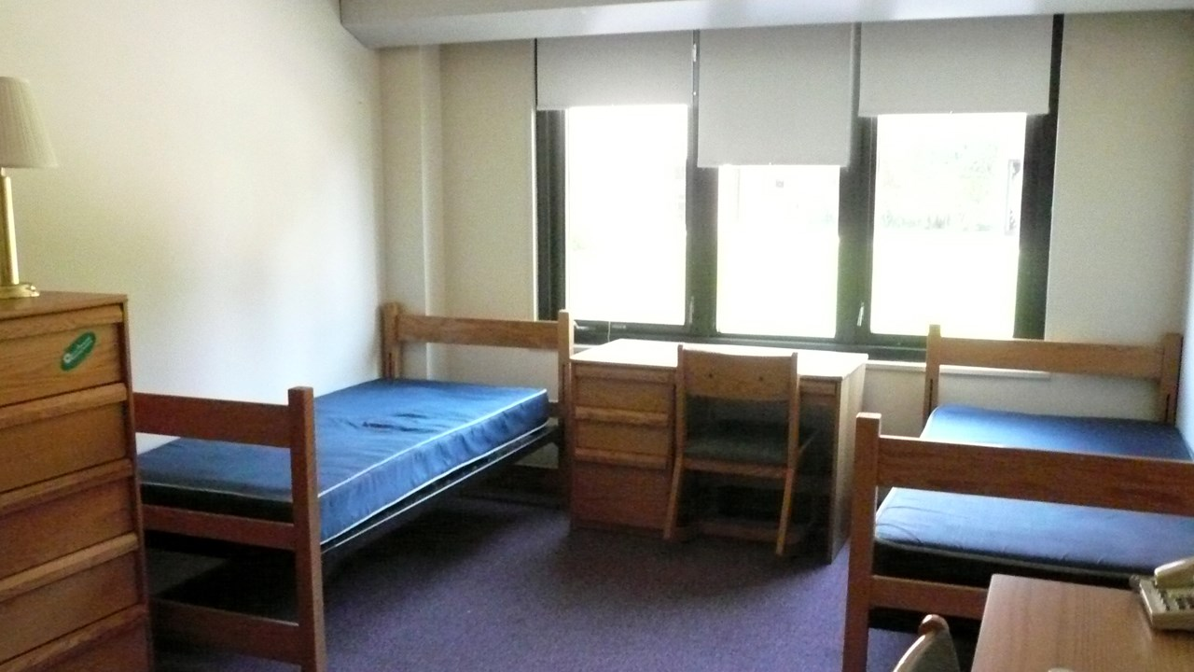
Introduction
Occupants are not passive -- Individuals can create spaces that reflect particular ambiances (Gosling et al., 2002; Graham et al., 2015)
  Relaxation and rejuvenation
  Studying and productivity
  Socializing with friends
  Stimulation and excitement
  Etc.
How critical is room ambiance to student mental health?

Slide 6
Ambiance Congruency
Time 1
September 2022
2021 Fall Semester:
  198 undergraduates recruited (163 retained for analysis)
  67% 1st year, 21% 2nd year, 11% 3rd year, 1% 4th year
Time 2
November 2022
2022 Spring Semester:
  75 pairs (n = 150) of undergraduate roommates
  64% 1st year, 34% 2nd year, 2% 3rd year
Time 3
February 2023
2022-2023 Academic Year:
  84 pairs (n = 168) of first year roommates
Time 4
April 2023

Slide 7
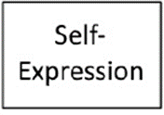
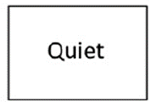

Ambiance Congruency
Q-Sort Procedure
  Description of ideal room
  Description of actual room
 |  |  | Productivity
 |  | Privacy | Fun | Friendship
 | Creativity | Entertaining | Inviting | Calm | Community
Uniqueness | Beauty | Excitement | Learning | Organization | Safety | Relaxation
Spirituality | Inspirational | Intimacy | Self-Expression | Cleanliness | Comfort | Quiet
Congruency score computed with correlation coefficient
Not at all important | Not very Important | Slightly Important | Somewhat Important | Moderately Important | Very Important | Extremely Important

Slide 8
Ambiance Congruency
Ambiance congruency is negatively associated with depressive symptoms, anxiety symptoms, and frequency of negative emotions.
  True even when controlling for:
    Demographics
    Big 5 Personality Traits
    Academic satisfaction
    Sense of connection with the school
    Physical health
  It was not associated with frequency of positive emotions
  Roommate’s scores did not predict mental health (just satisfaction)

Slide 9
Ambiance Congruency
Evidence that room ambiance changes for the better following periods of high stress (controlling for current stress)
Previous
Ambiance Congruency
Current
Ambiance Congruency
Previous
Stress
Current
Stress

Slide 10
Identifying Room & Student Types
 |  |  | Productivity
 |  | Entertaining | Fun | Quiet
 | Creativity | Community | Inviting | Friendship | Safety
Uniqueness | Beauty | Excitement | Learning | Organization | Calm | Comfort
Spirituality | Inspirational | Intimacy | Self-Expression | Cleanliness | Privacy | Relaxation
Inverted Factor Analysis
    Actual Rooms on Campus:
      Group 1:
      Group 2:
      Group 3:
Peaceful Solitude

Slide 11
Identifying Room & Student Types
 |  |  | Self-Expression
 |  | Organization | Calm | Relaxation
 | Quiet | Privacy | Productivity | Entertaining | Comfort
Inspirational | Beauty | Uniqueness | Cleanliness | Safety | Community | Friendship
Spirituality | Intimacy | Learning | Creativity | Excitement | Inviting | Fun
Inverted Factor Analysis
    Actual Rooms on Campus:
      Group 1:
      Group 2:
      Group 3:
Peaceful Solitude
Fun Social Activity

Slide 12
Identifying Room & Student Types
 |  |  | Beauty
 |  | Quiet | Productivity | Safety
 | Excitement | Community | Privacy | Cleanliness | Organization
Spirituality | Entertaining | Uniqueness | Creativity | Relaxation | Inviting | Comfort
Intimacy | Inspirational | Learning | Fun | Calm | Self-Expression | Friendship
Inverted Factor Analysis
    Actual Rooms on Campus:
      Group 1:
      Group 2:
      Group 3:
Peaceful Solitude
Fun Social Activity
Personal Control
23%
44%
33%
Notes:
Men more likely to be in Group 1, less likely in Group 3

Slide 13
Identifying Room & Student Types
 |  |  | Productivity
 |  | Community | Inviting | Calm
 | Intimacy | Entertaining | Self-Expression | Organization | Privacy
Inspirational | Excitement | Creativity | Fun | Quiet | Safety | Comfort
Spirituality | Uniqueness | Beauty | Learning | Friendship | Cleanliness | Relaxation
Inverted Factor Analysis
    Ideal Room Preferences:
      Group 1:
      Group 2:
      Group 3:
Peaceful Solitude

Slide 14
Identifying Room & Student Types
 |  |  | Organization
 |  | Calm | Fun | Inviting
 | Beauty | Quiet | Learning | Relaxation | Safety
Intimacy | Spirituality | Excitement | Self-Expression | Productivity | Community | Friendship
Inspirational | Uniqueness | Creativity | Entertaining | Privacy | Cleanliness | Comfort
Inverted Factor Analysis
    Ideal Room Preferences:
      Group 1:
      Group 2:
      Group 3:
Peaceful Solitude
Social Activity

Slide 15
Identifying Room & Student Types
 |  |  | Cleanliness
 |  | Organization | Calm | Safety
 | Beauty | Productivity | Creativity | Privacy | Fun
Learning | Intimacy | Uniqueness | Community | Inviting | Entertaining | Comfort
Spirituality | Inspirational | Quiet | Excitement | Self-Expression | Friendship | Relaxation
Inverted Factor Analysis
    Ideal Room Preferences:
      Group 1:
      Group 2:
      Group 3:
Peaceful Solitude
Social Activity
Expressive Fun
18%
45%
37%
Notes:
Men more likely to be in Group 1, less likely in Group 2

Slide 16
Identifying Room & Student Types
    Actual Rooms on Campus:
      Group 1:
      Group 2:
      Group 3:
23%
Peaceful Solitude
Fun Social Activity
17%
31%
Personal Control
36%
7%
60%
66%
33%
28%
    Ideal Room Preferences

Slide 17
General Discussion
Across the three studies, we see evidence that actual-ideal ambiance congruency is associated with mental health
  Reductions in stress co-occurs with improved room ambiance
Students seem to differ primarily in terms of how much they prioritize and experience social activity, peace/quiet, and self-expression.

Slide 18



Thanks!
  Brynn Anderson
  Kayla Brady
  Elliana Hamilton
  Nhi Hoang
  Emma Kane
  Tyler Kennedy
  Lauren Quillan
  Isabel Santos
  Kate Yakes
  Undergraduate Researchers:
  Alyssa Cheadle
  Loren Toussaint
  Christine Guardino

