Slide 1
How the Frost Center can Support your Research Program
Frost Center Colloquia
October 21, 2025
Daryl Van Tongeren Director, Frost Center for Social Science Research

Slide 2
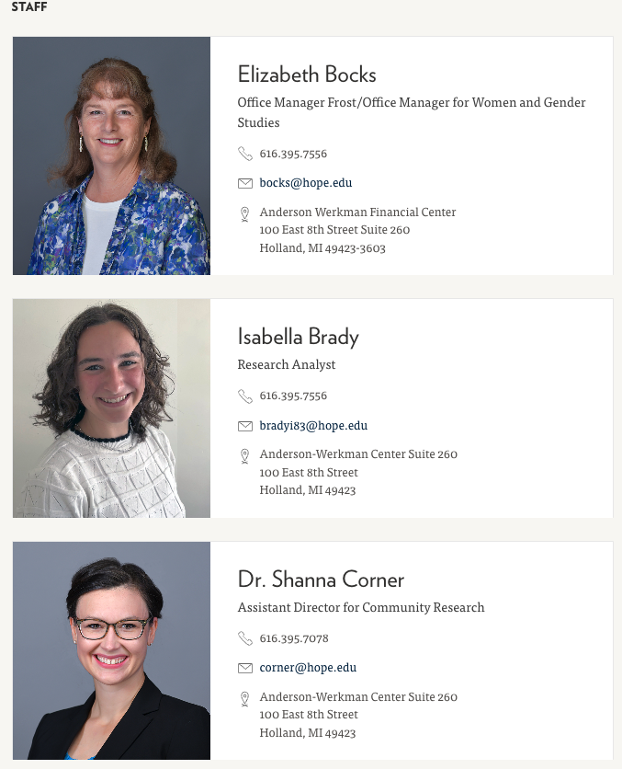
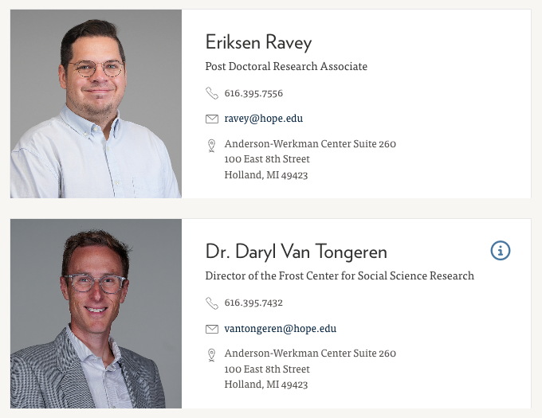
Overview of the Frost Center
Who we are:

Slide 3
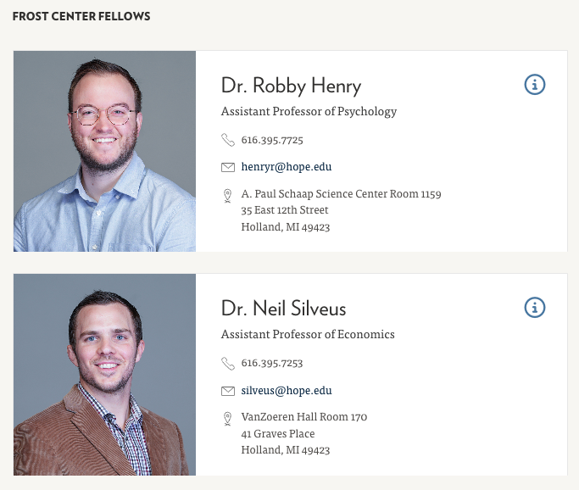
Overview of the Frost Center
Who we are:

Slide 4
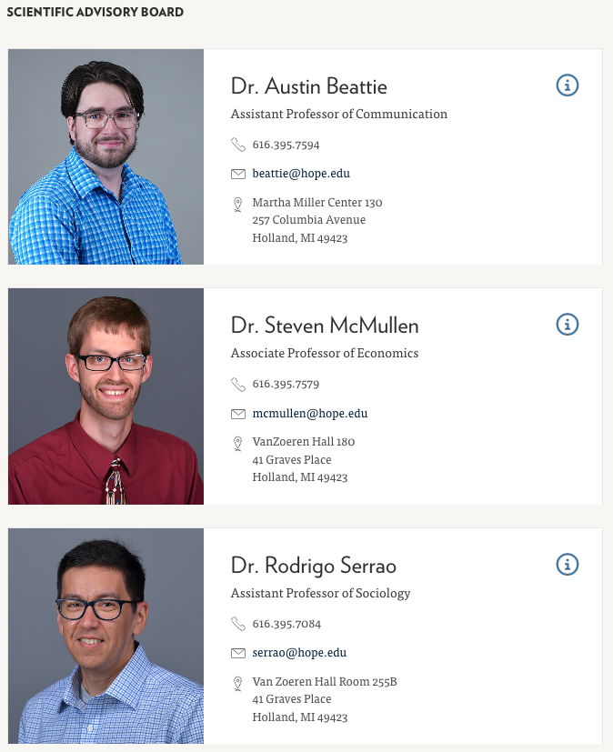
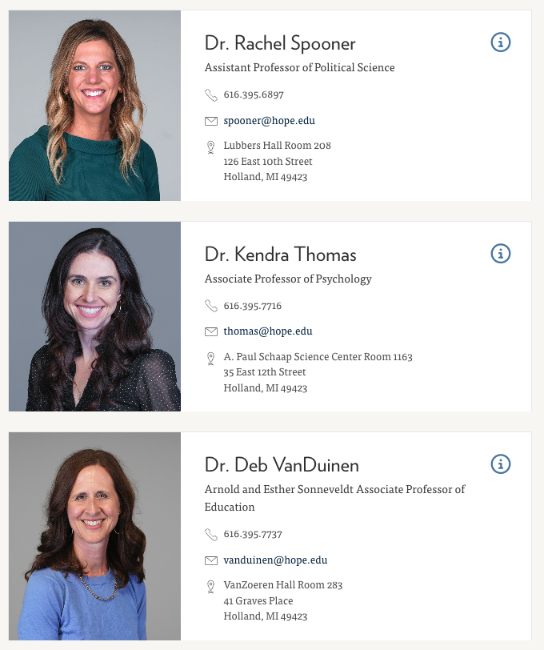
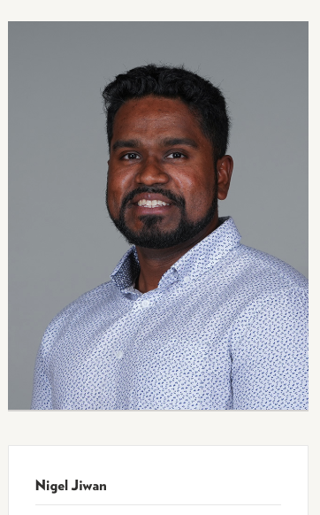
Overview of the Frost Center
Who we are:

Slide 5
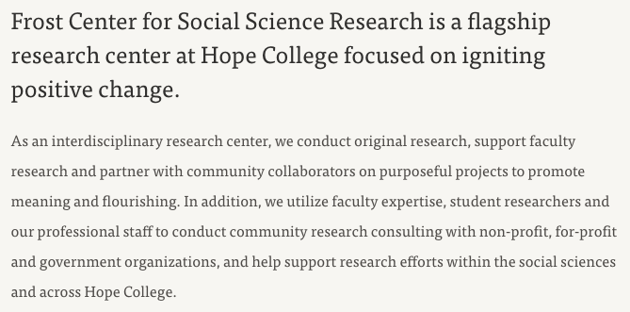
Overview of the Frost Center
What we do:

Slide 6
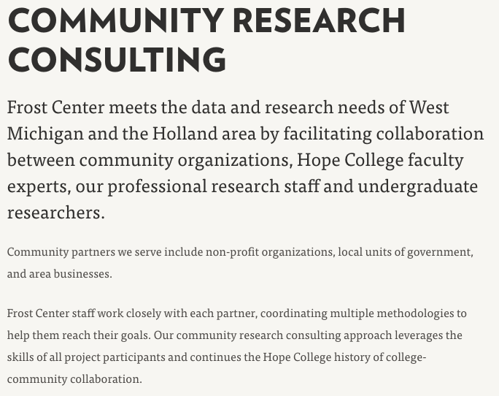
Overview of the Frost Center
What we do:

Slide 7
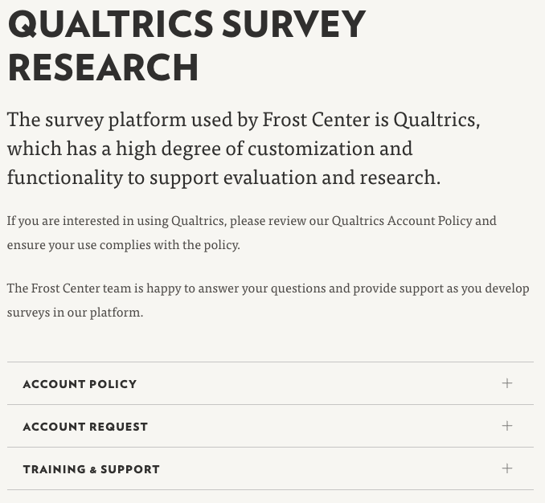
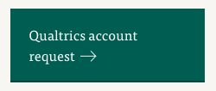
Overview of the Frost Center
What we do:

Slide 8

Overview of the Frost Center
What we do:
Internally, we
Support grant-funded research
Conduct research with internal stakeholders
Host internal surveys (e.g., CURCA evaluation)
Manage faculty elections
Conduct administrator evaluations (Chair, Dean, Provost)
Manage Qualtrics

Slide 9
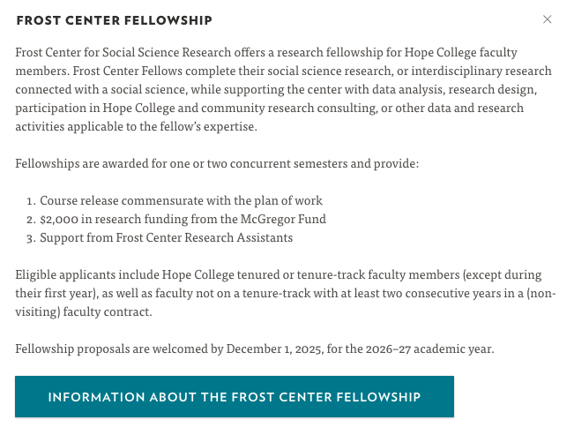
Frost Center Fellowship

Slide 10
Grant Support
We offer grant-related support for faculty writing proposals who would like to leverage the resources of a large research center
Conducting survey research
Administering longitudinal surveys
Personalizing results
Report writing
Collaborating with research staff and student research assistants
Grant administration (post-award), such as processing consultant payments, paying student RAs, organizing conferences / events

Slide 11
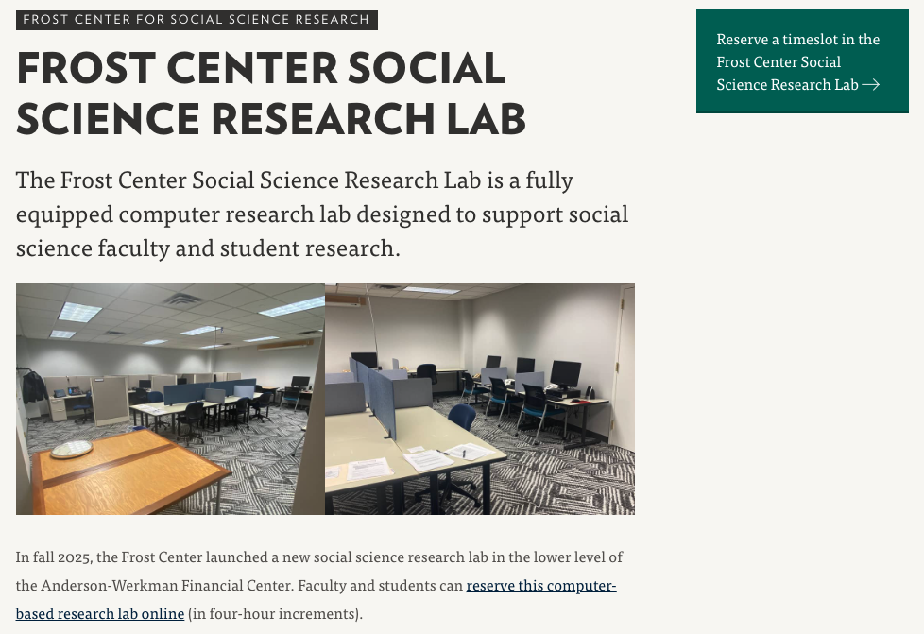
Social Science Research Lab
Open house next Tuesday (October 28) from 2-4pm

Slide 12
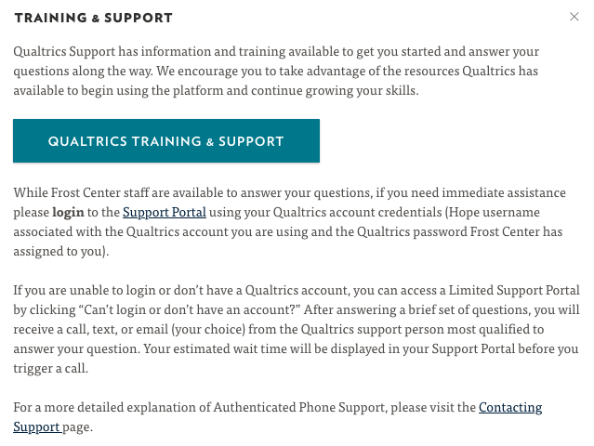
Trainings
We are developing trainings for you and your student research assistants

Slide 13
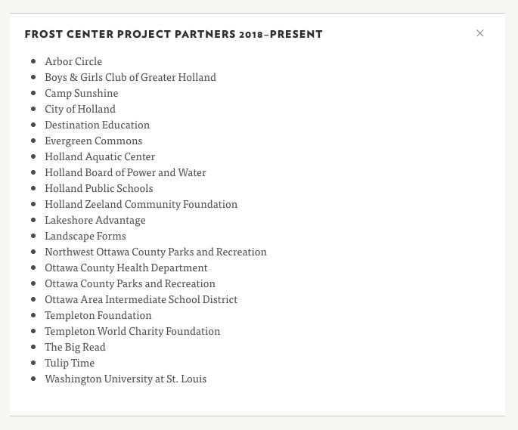
Community-Based Partnerships
We have a very active portfolio of community-based research partnerships

Slide 14
Visiting your Classroom
We have given (and can give) presentations on
Applied vs. basic research
Research methodology and study design
Surveys and statistics
Working with community-based partnerships

Slide 15
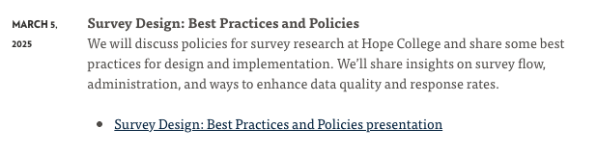
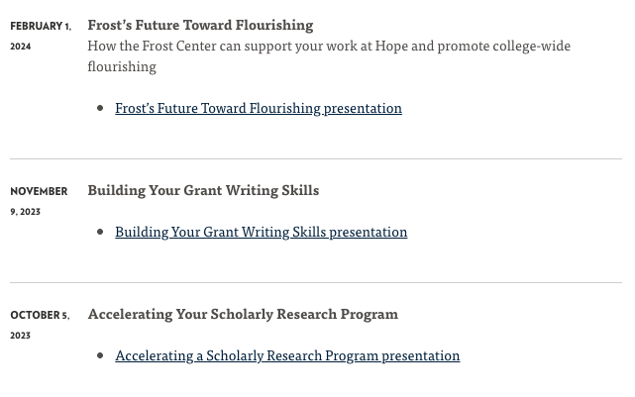
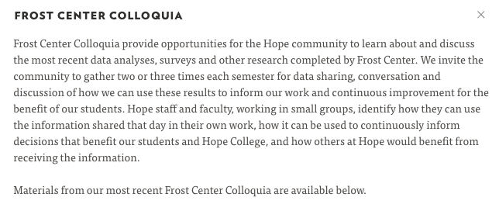
Resources
Previous colloquia
Seeking grant-funding
Establishing a productive research program
Best practices in survey design

Slide 16
Let’s discuss!
What questions do you have?
What research needs do you have?
How might the Frost Center support your research?

Slide 17
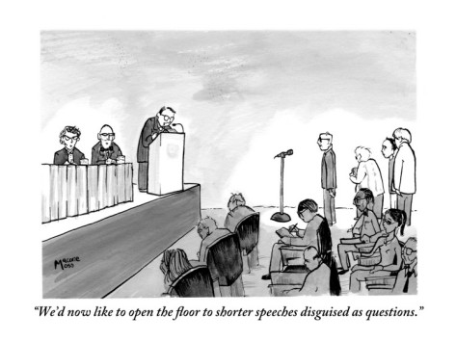
Thank you!
Please send us your questions and ideas!
vantongeren@hope.edu
frostcenter@hope.edu

