Slide 1


Longitudinal Research
&
Advanced Functions in Qualtrics
Anita Esquerra-Zwiers, Ph.D., RN, CBS
Associate Professor
Nursing Department

Slide 2
Objectives
Introduce My MMMI Lactation Coach
Share advanced functions in Qualtrics

Slide 3


My MMMI Lactation Coach
Mother’s Milk For Michigan Infants Research Team

Slide 4
Aims of My MMMI Lactation Coach
Evaluate the impact of My MMMI LC using existing care models on lactation outcomes.
Existing Care Models
In home lactation providers standard of care
Women Infant Children
Maternal Infant Health Program
Lactation Outcomes
  Attitudes, Social Norms, Perceived Behavioral Control
  Exclusivity and Duration
Examine the effectiveness of breastfeeding duration and exclusivity in reducing maternal health and infant health outcomes
  Maternal health outcomes: Blood pressure, BMI, anxiety, depression, sleep
  Infant health outcomes: Infant growth trajectories, well:sick visits
Describe human milk sodium and potassium concentrations over the first 14 days of lactation
  Sodium and Potassium are biomarkers for the phases of lactation

Slide 5
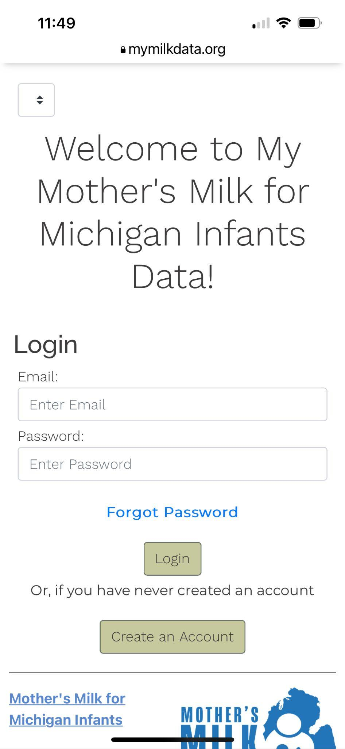
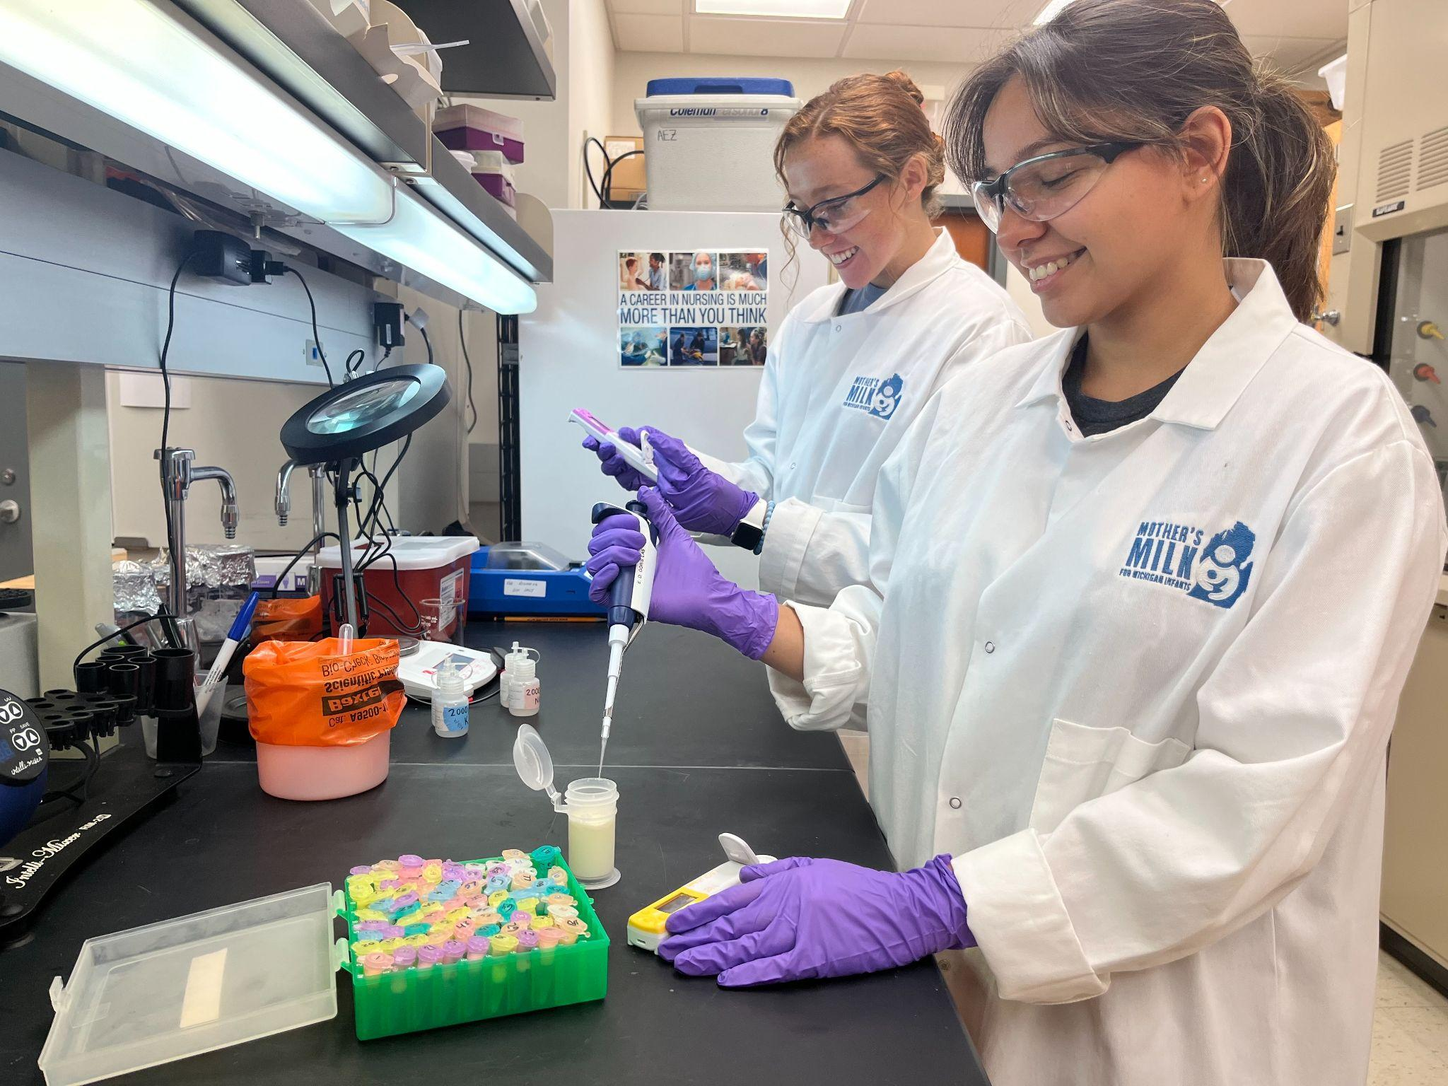
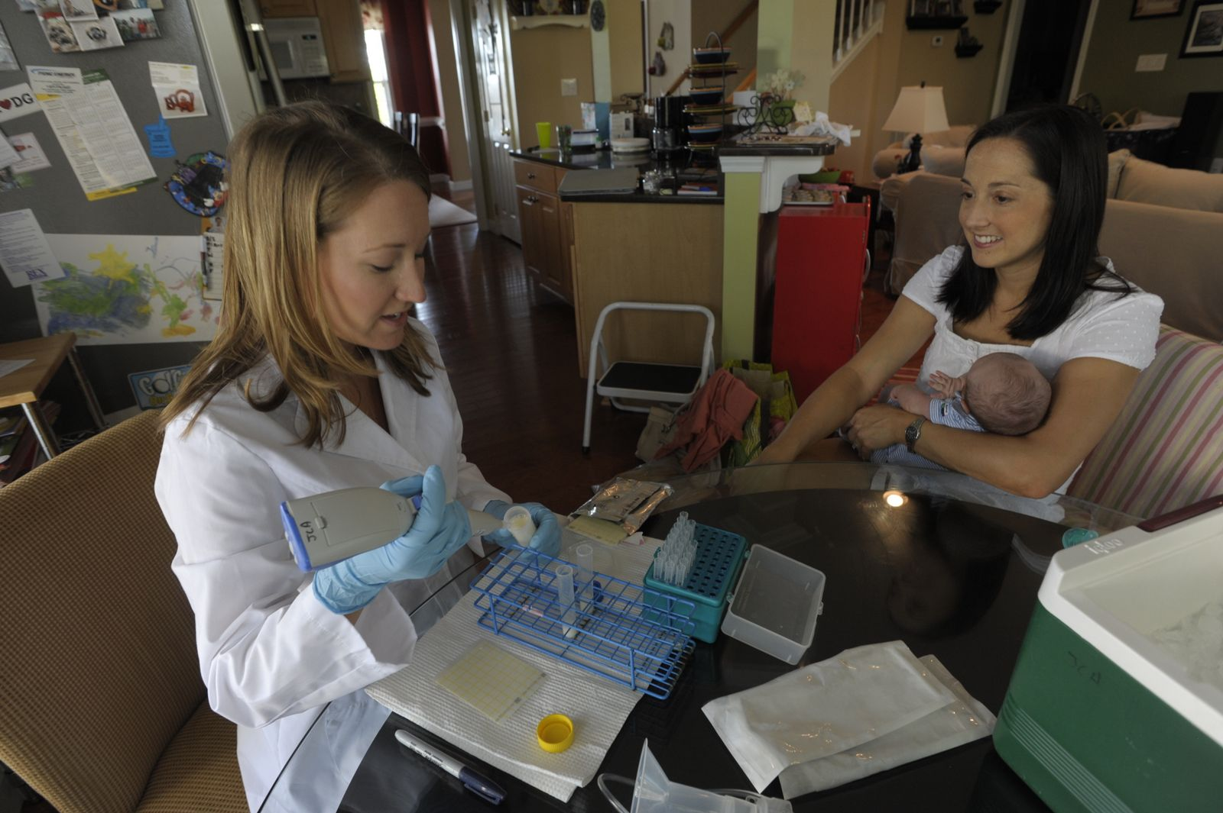
My MMMI Lactation Coach
Access to My MMMI Data
  Targeted timed education
  Logs: Feeding/Pumping/Diaper/Visits
  Modes: Pregnancy & Baby
Lactation Provider Visits
  2 visits during the first 2 weeks
  Education
  Precision Lactation Protocols
  Milk Analysis
Weekly Phone Calls x 5
Milk Collection & Analysis x14 days
Surveys
Participants
  Maternal Infant Health Programs
  Women Infant Children

Slide 6
Surveys
Health and Pregnancy
Milk Supply 1-5
Conset
Eligibility
Birth
Health and Lactation-
1 month
Health and Lactation-
3 & 6 month
Post Birth Assessment

Slide 7
General Tips
Have a separate student research account- collaborate
  You will need to get a different email address
Use the Qualtrics Help Desk

Slide 8
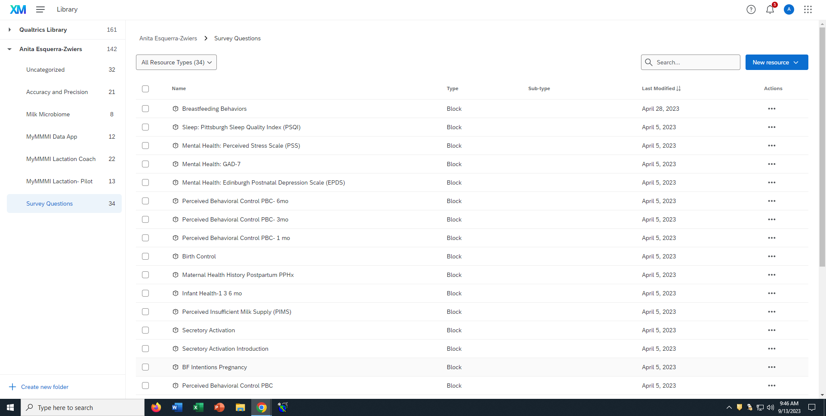
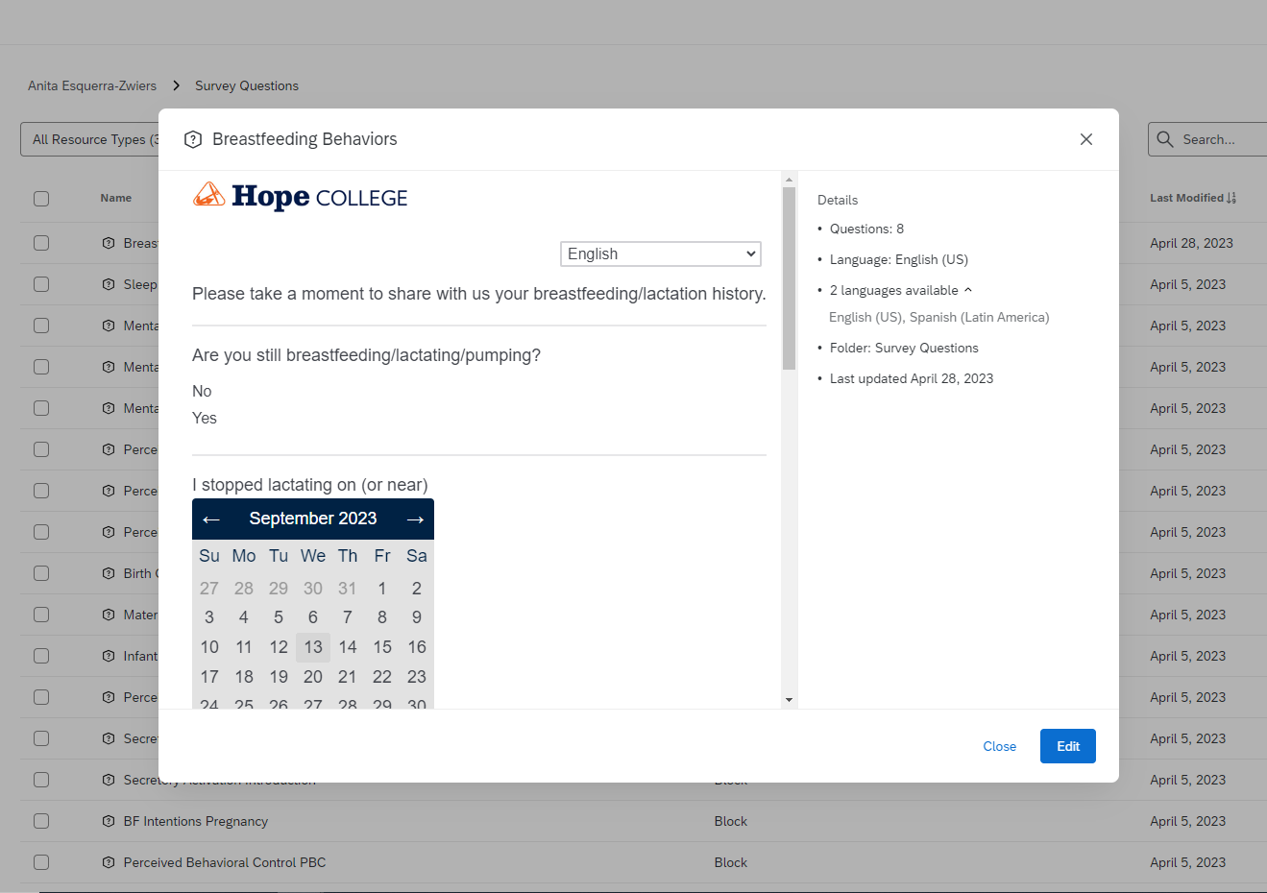
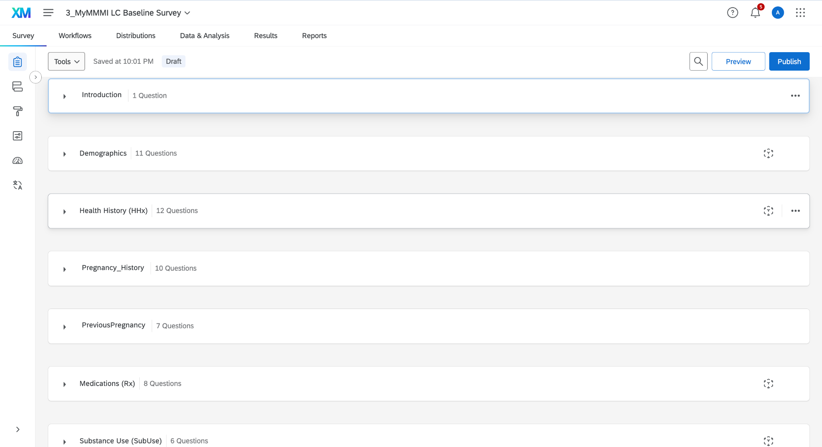
Building your Library: Question Blocks
Helpful Tips
  Most useful way to manage question
  Copy or link to survey
Lessons Learned
  Build these first
  Customize

Slide 9
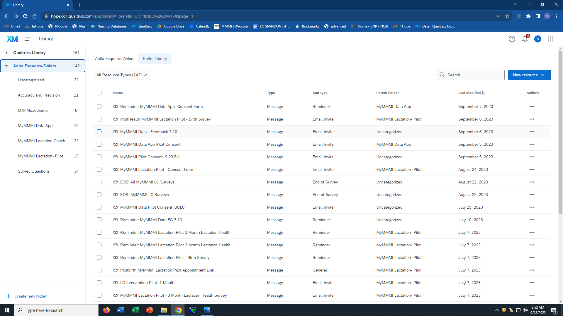
Building your Library: Messages
Helpful Tip
Know type and subtypes
Categorize
Label: 1st Email, Reminder, Consent,...
Copy or Save As
Lessons Learned
Messages need to be universal
Avoid using dates
If you need to personalize the message when sending from project
Clean up regularly

Slide 10
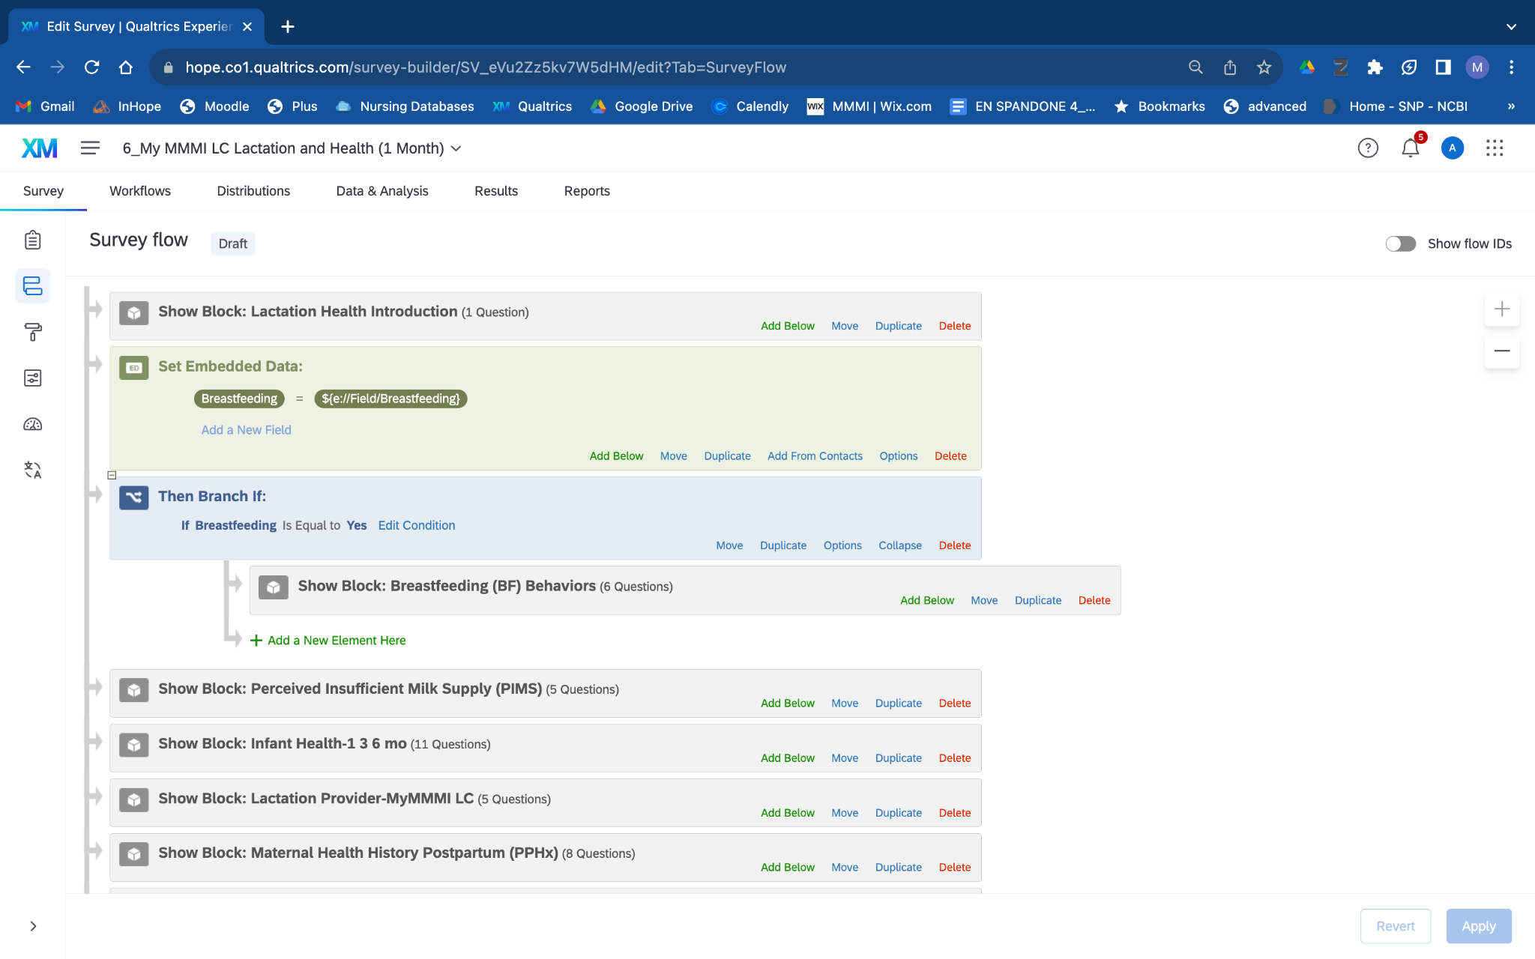
Survey Flow
Conditional Questions
Example: If participant marked in a previous survey that they are no longer breastfeeding the Breastfeeding Block will not be displayed

Slide 11
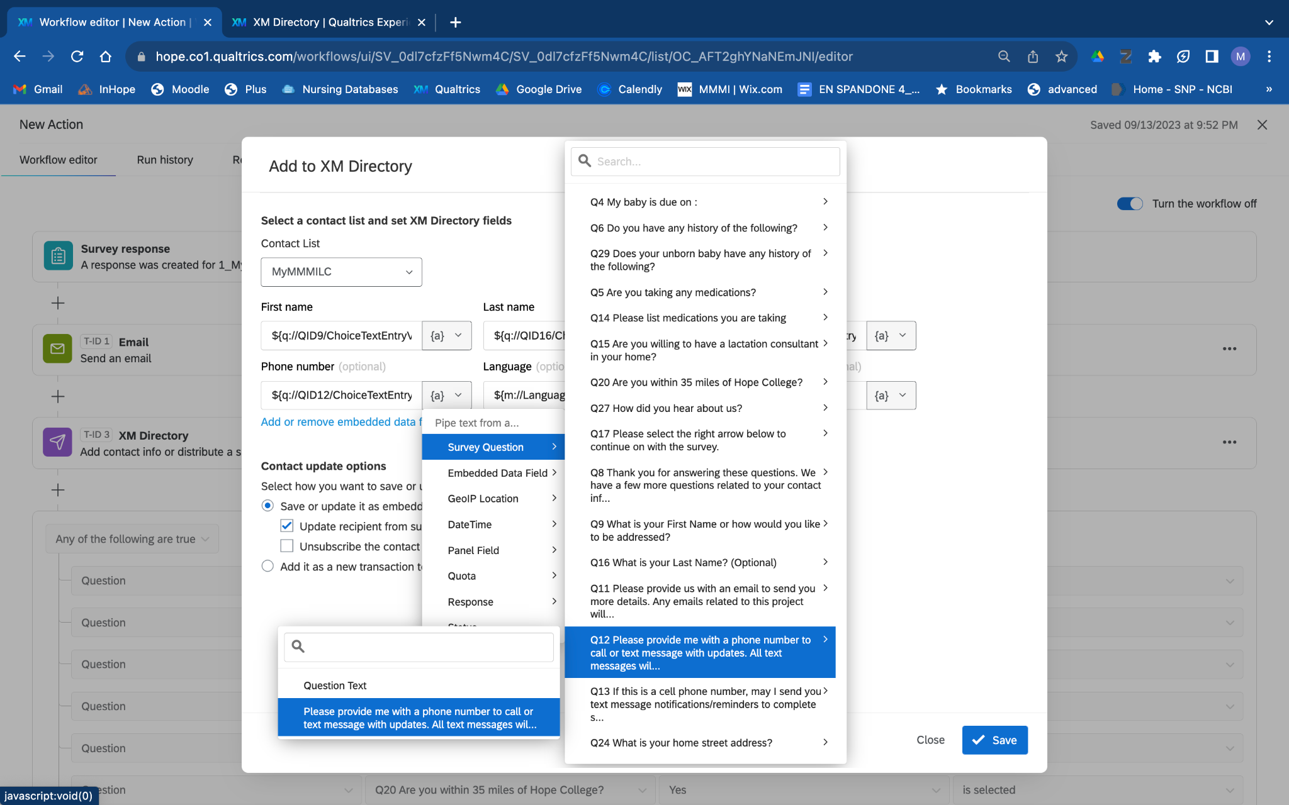
Workflow: Create a Directory

Slide 12
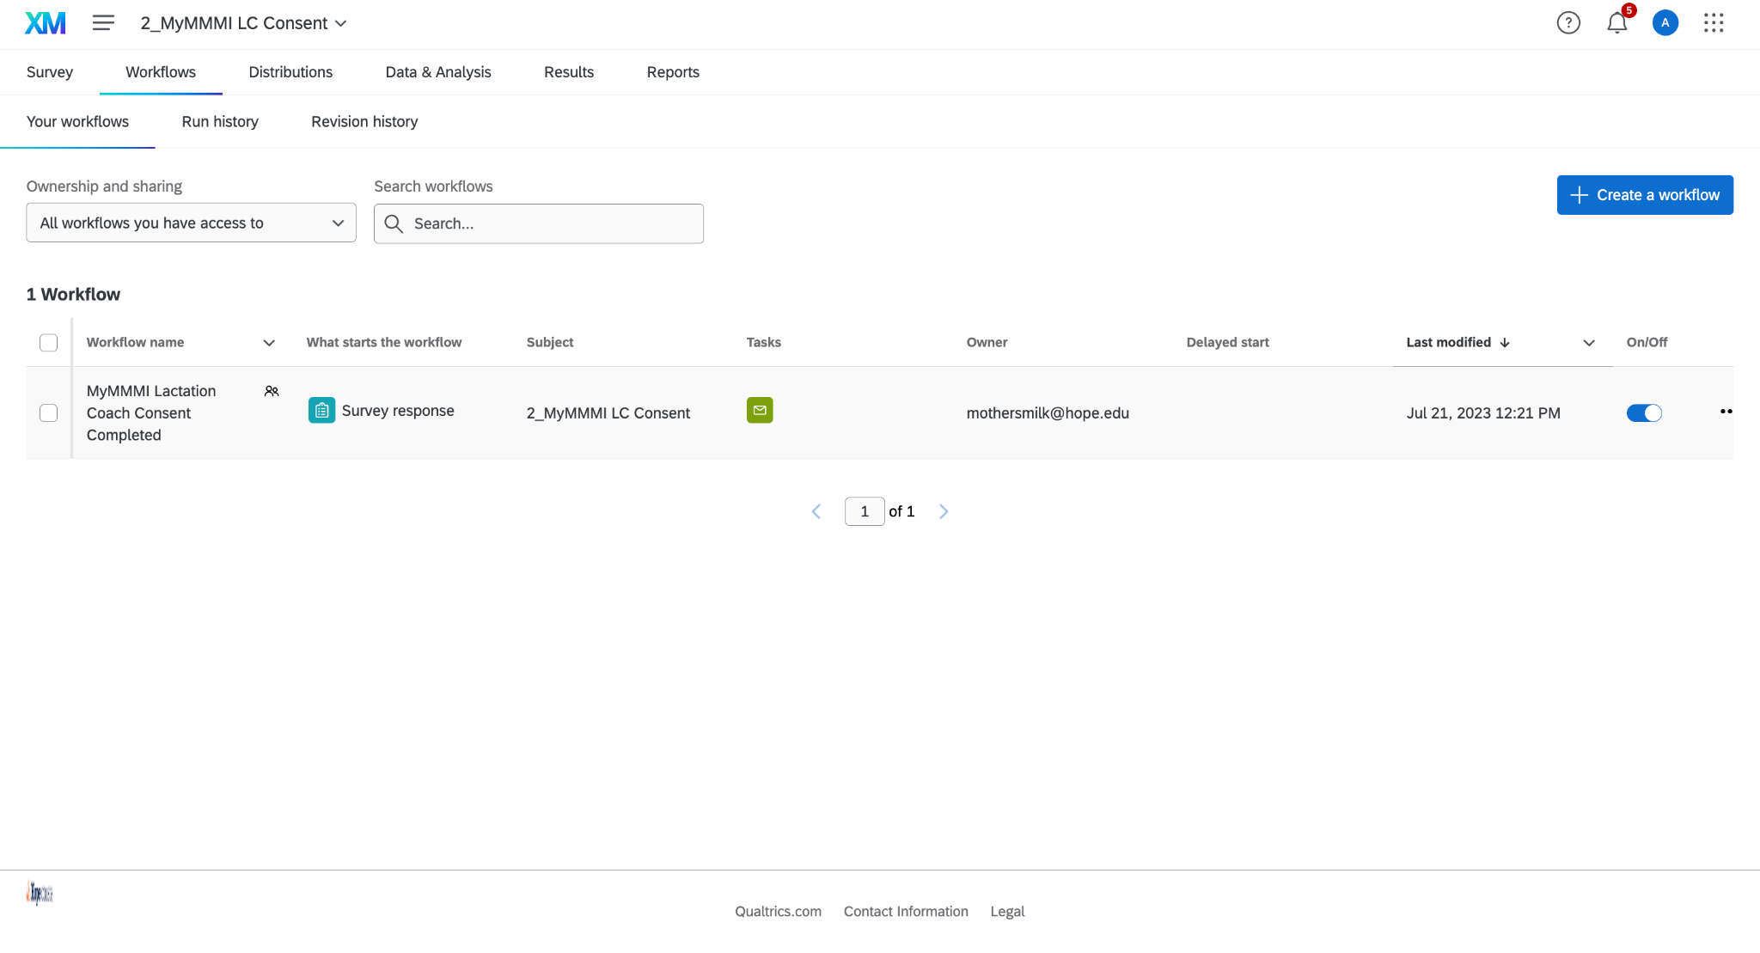
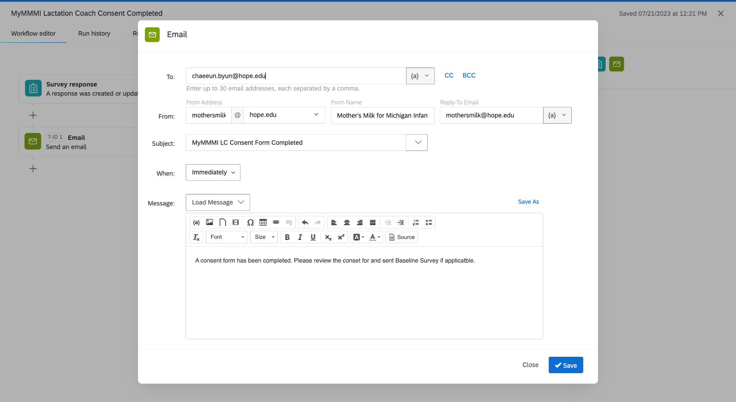
Workflows: Send Notifications to Team

Slide 13
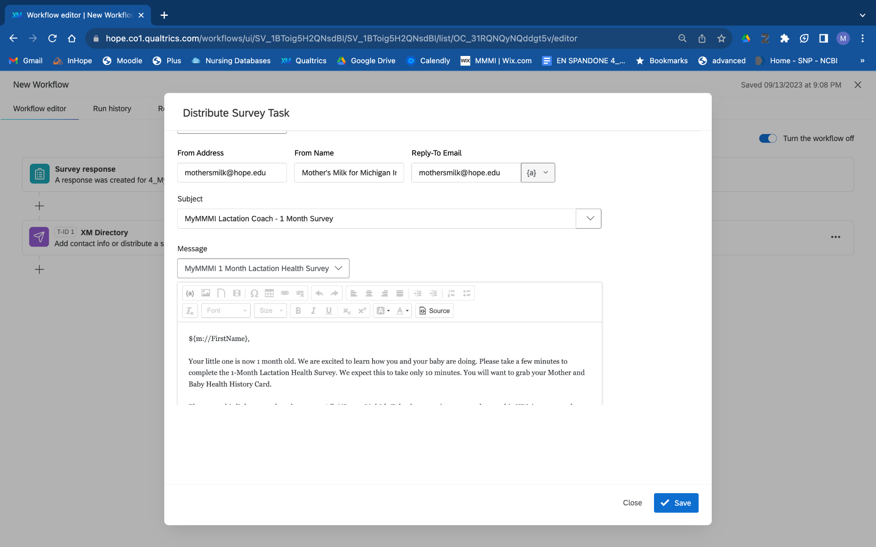
Workflows: Link to Next Survey

Slide 14
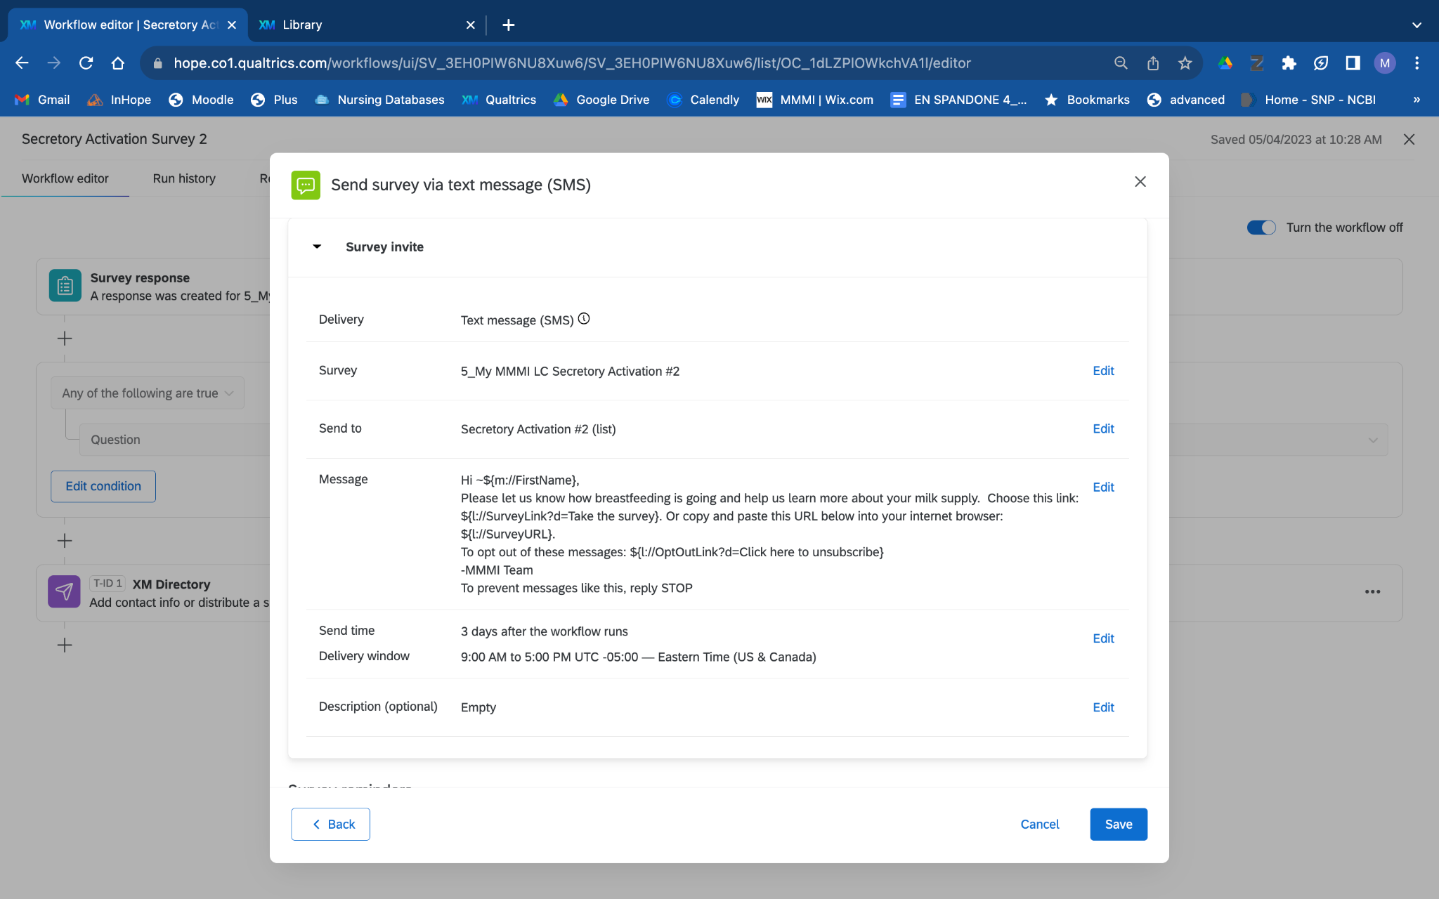
SMS Messaging
***Special feature***
Need to have verbiage created before releasing
Make sure consent form addresses
Have to offer STOP
Costs: Contact Frost Research Center

Slide 15
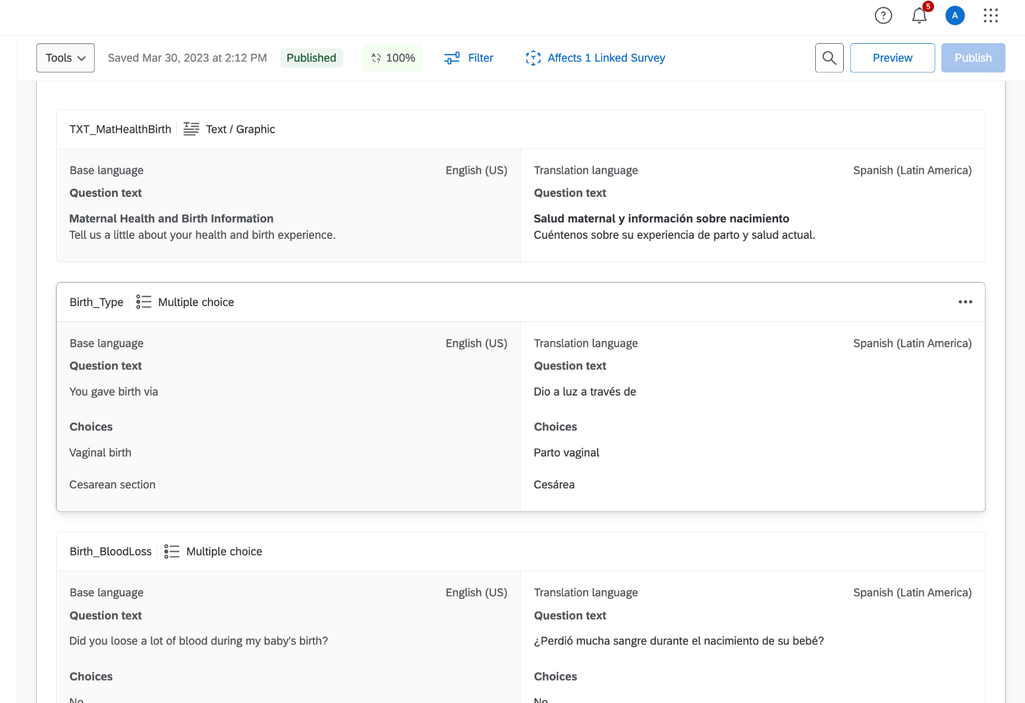
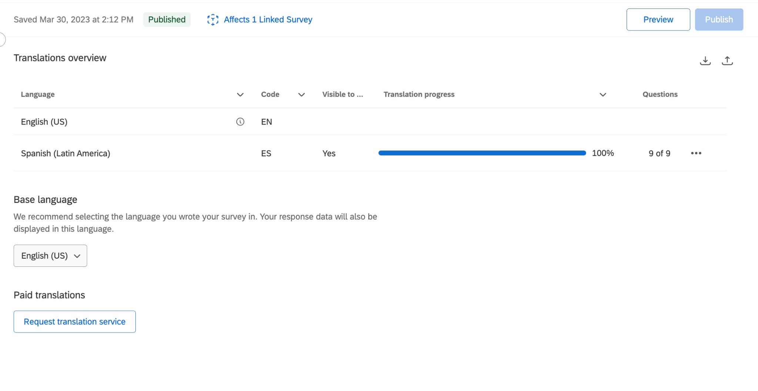
Translations
Helpful Tips
Company works with Qualtrics that can translate your surveys and add them to your projects
Lessons Learned
Check translation progress
Each time you change the primary language survey you will need to verify the translated version

Slide 16
Next Steps
FUNDED!!! Blue Cross Blue Shield of Michigan Foundation
HSRB: Complete proposal and obtain approval
Train Lactation Providers

Slide 17
Thank You
Undergraduate Research Students
Hibist Demilie- ‘22
Jeannie (Phuong Anh) Vu- ‘23
Isabel (Sofia) Lopez- ‘23
Delaney Wesolek
Erin Matheny
Aurore Shima
Lydia (Chaeeun) Byun
Collaborators
Alyssa Cheadle, PhD Hope College Psychology
Tricia Johnson, Rush University
Rebecca Antaya, RD Nourished Beginnings
Ottawa County Department of Public Health- Maternal Infant Health Program
Becky Shanahan, RN and Beth Curley, RN, 2 for Baby
Anne Dalton, OT, Foundational Feeding

