Slide 1
Meet the Incoming Class of 2026
Frost Center Friday
September 30, 2022
Meredith Phillips, Associate Director for Admissions Data and Systems
Donald Friesner, Director of Institutional Research
hope.edu/frostcenter
hope.edu/data

Slide 2
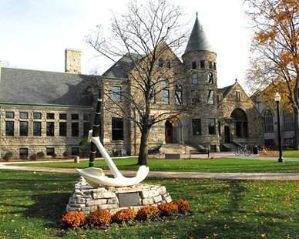
Today’s Agenda
Overview of the Class of 2026
  Who are they
  Where are they from?
  How did they get here?
Hope Forward data
Overview of HEDS New Student Survey
  Key findings
Discussion, conversation, questions

Slide 3
Class of 2026 Fast Facts
955
First-Time in College
64% Female
36% Male
19%
Students of Color

Slide 4
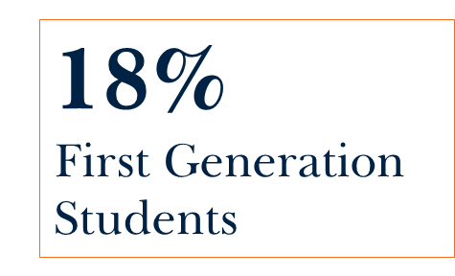
Fast Facts, Continued
Top Academic Interests
Business
Psychology
Nursing
Medicine (Pre-Professional)
Biology
18%
Pell Awarded

Slide 5
Academic Record
GPA
Avg. 3.81
3.54-4.0
Middle 50th Percentile
90%
Received an Academic Merit
Scholarship
ACT
Avg. 27
25-30
Middle 50% - ACT Scores
SAT
Avg. 1205
1080-1320
Middle 50% - SAT Scores
56%
Submitted an Official Test Score
10
National Merit Scholars

Slide 6
Where are they from?
3% International
9%
Out of Region
238 Michigan High Schools
33 States
17 Countries
20%
Out of State
67% Michigan

Slide 7
How did we get here?
Increased Applications
22.7% Yield
Yield has been 21-25% over the past 5 years
Improved marketing and encouraging students to apply
More ways to apply
Continuing to Offer Visit Experiences

Slide 8

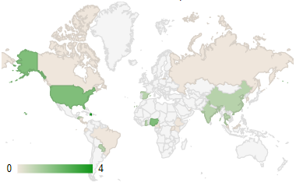
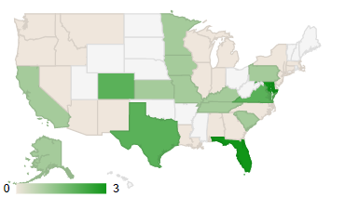
36 Students
15 International
21 Domestic
11 Countries
15 States

Slide 9
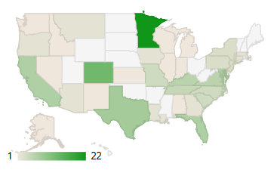
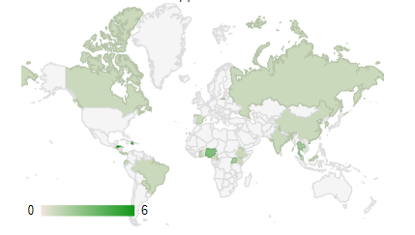
Hope Forward Applicants
46% of students who applied for the Hope Forward Program enrolled at Hope
Compared to 22.7% overall Yield
Applicants were from 32 States and 22 Countries

Slide 10
Higher Education Data Sharing Consortium (HEDS)
New Student Survey
About the Survey
Prompts students:
  To reflect of their goals for college
  Their vision of a successful life after college
  How their experiences in college will help lead them to that vision.
No extra cost to the College to administer
Types of questions
  What do they worry about?
  How much time they plan to spend on various activities.
  Would they like to have a follow-up conversation with other on campus about their goals, and ways to improve their college experience.

Slide 11

Unique Aspects of New Student Survey
Students immediately receive link to summary of how other students responded answered.
Based on students response to seeking a follow-up conversation
  Email is automatically sent to designated person based on response chosen

Slide 12
Survey Administration
Population: 911 students, age 18 and over
Response Rate: 78%
Permission to be contacted: 602 (some with multiple permissions)
Students seeking more information: 329 Unduplicated

Slide 13
Demographics of Respondents

Slide 14
A few key and interesting findings

Slide 15
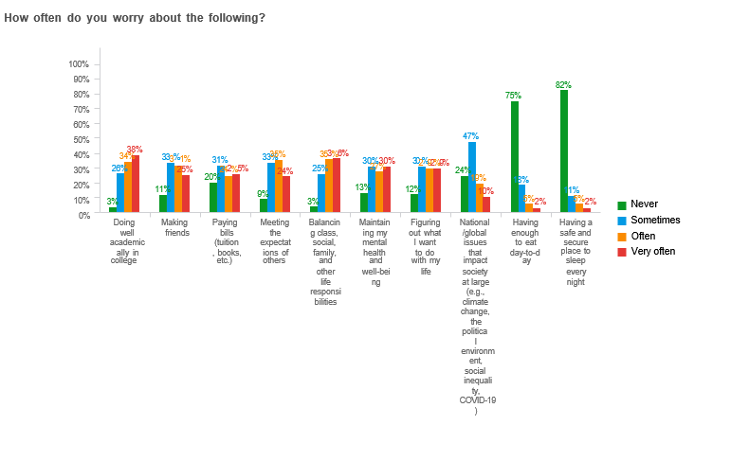
25% worry at least sometimes about having enough to eat day-to-day
18% worry at least sometimes about having a place to sleep every night

Slide 16
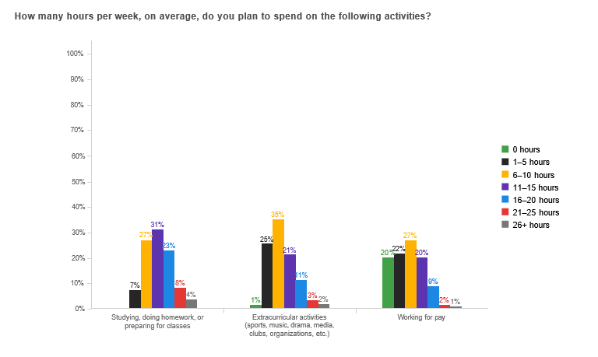
How many hours per week do we assume students to spend studying per class?
34% expect to spend 10 hours or less per week studying and preparing for class.
38% plan to spend at least 11 hours per week doing extracurricular activity

Slide 17
And finally…
50% of all respondents stated that they neither agreed nor disagreed with the statement, “My academic experiences will be the most enjoyable part of college.”

Slide 18
Discussion, conversation, questions
Who at Hope College (positions or departments) would benefit from the information shared today?
Thinking about your own work at Hope, how might you use what you’ve learned today?
How might data from this presentation continuously inform decisions to benefit Hope students?

