Slide 1
Risk Factors Analysis – Identifying At-Risk Students Before They Reach Campus
April 18, 2024
Donald Friesner, Director of Institutional Research
hope.edu/frostcenter
hope.edu/data

Slide 2

Risk Factors Analysis
A simple method for determining students at risk for attrition before they arrive on campus
A way to measure the impact of individual risk factors
A way to measure the impact of multiple risk factors

Slide 3
Method
Choose a set of risk factors from literature (academic, financial, minority, first generation)
Academic Risk Factor – A large drop-off in retention with HS GPA under 3.3
Low Income Risk Factor - Pell Eligible
Minority Risk Factor - Minority Status
First Generation Risk Factor - Neither Parent any College - From FAFSA
Identify students with risk factor(s)
Track historic prevalence and impact on retention
Calculate Relative Risk
Predict future retention based on incoming class

Slide 4
Risk Factors Analysis
A simple method for determining students at risk for attrition before they arrive on campus
A way to measure the impact of individual risk factors
A way to measure the impact of multiple risk factors

Slide 5
Use
Literature indicates early intervention has the most impact
By the time a student struggles in their first year intervention is likely too late
Risk Factors Analysis identifies incoming students likely to be at risk for attrition
Gives ability to reach out to at risk students with intervention specific to their risk factor(s) BEFORE issues arise

Slide 6
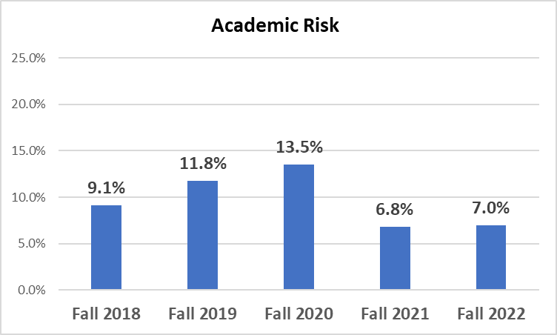
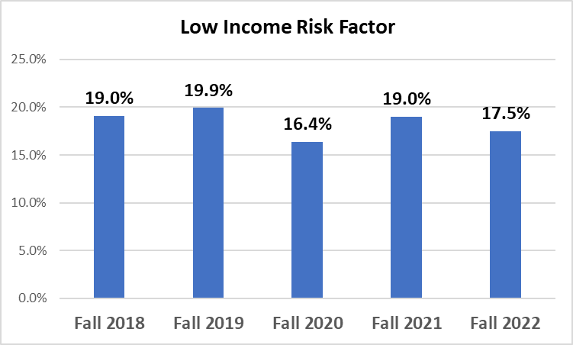
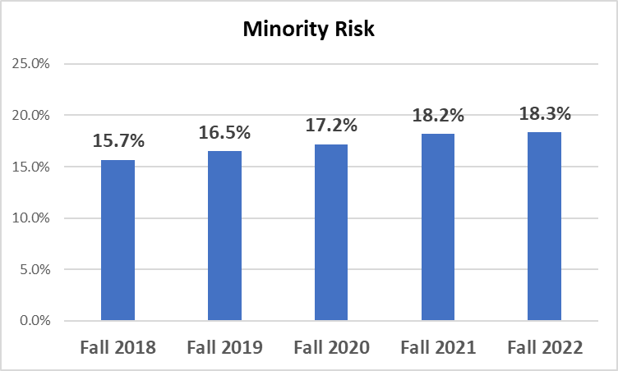
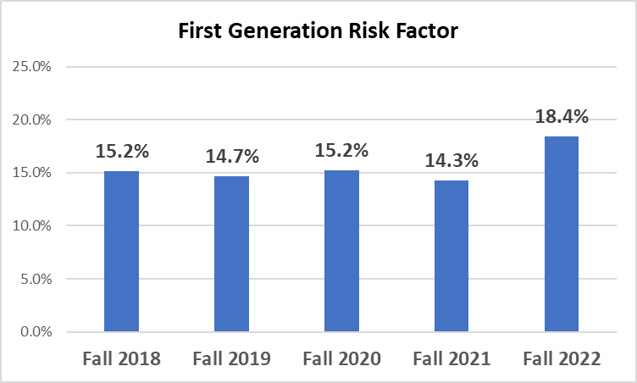
Historic Prevalence

Slide 7
Impact of Risk Factors - Retention Rates for Those With and Without Risk Factor
Analysis uses First Time in Any College (FTIAC) cohorts from Fall 2018 through Fall 2022

Slide 8
Academic Risk Factor
Present? | Attrition | Retain | Total | Retention | Relative Risk
Yes | 80 | 304 | 384 | 79.2%
No | 348 | 3,322 | 3,670 | 90.5%
Total | 428 | 3,626 | 4,054 | 89.4% | 2.20
Source: Application A cut off at HSGPA of 3.3 for factor

Slide 9
Low Income Risk Factor
Present? | Attrition | Retain | Total | Retention | Relative Risk
Yes | 110 | 644 | 754 | 85.4%
No | 324 | 3,025 | 3,362 | 90.0%
Total | 434 | 3,682 | 4,116 | 89.5% | 1.51
Source: Financial Aid , Banner. Students who ACCEPTED Pell Grants

Slide 10
Minority Risk Factor
Present? | Attrition | Retain | Total | Retention | Relative Risk
Yes | 96 | 613 | 709 | 86.5%
No | 338 | 3,069 | 3,407 | 90.1%
Total | 434 | 3,682 | 4,116 | 89.5% | 1.36
Source: Banner Student Records

Slide 11
First Generation Risk Factor
Present? | Attrition | Retain | Total | Retention | Relative Risk
Yes | 103 | 542 | 645 | 84.0%
No | 331 | 3,140 | 3,471 | 90.5%
Total | 434 | 3,682 | 4,116 | 89.5% | 1.67
Source: Application

Slide 12
Retention by Number of Risk Factors
# of Risk Factors | Attrit | Retained | Total | Retention rate | Percent of total
0 | 203 | 2,279 | 2,482 | 91.8% | 60.3%
1 | 123 | 907 | 1,030 | 88.1% | 25.0%
2 | 69 | 306 | 375 | 81.6% | 9.1%
3 | 35 | 169 | 204 | 82.8% | 5.0%
4 | 4 | 21 | 25 | 84.0% | 0.6%
Total | 434 | 3,682 | 4,116 | 89.5% | 100.0%
Note that 14.7% of the population have 2 or more risk factors (9.1%+5.0%+.6%). With an entering class of 900 students, 133 students would be expected to have 2 or more risk factors (900*.147=132.3).

Slide 13
A Comparison (or, how I expected it to work)
Hope College, 2018-2022 Cohorts
CMU, 2008-2012 Cohorts
# of Risk Factors | Attrit | Retained | Total | Retention rate | Percent of total
0 | 203 | 2,279 | 2,482 | 91.8% | 60.3%
1 | 123 | 907 | 1,030 | 88.1% | 25.0%
2 | 69 | 306 | 375 | 81.6% | 9.1%
3 | 35 | 169 | 204 | 82.8% | 5.0%
4 | 4 | 21 | 25 | 84.0% | 0.6%
Total | 434 | 3,682 | 4,116 | 89.5% | 100.0%
# of Risk Factors | Attrit | Retained | Total | Retention rate | Percent of total
0 | 1,956 | 8,372 | 10,328 | 81.1% | 54.6%
1 | 1,459 | 4,288 | 5,747 | 74.6% | 30.4%
2 | 713 | 1,460 | 2,173 | 67.2% | 11.5%
3 | 230 | 327 | 557 | 58.7% | 2.9%
4 | 46 | 59 | 105 | 56.2% | 0.6%
Total | 4,404 | 14,506 | 18,910 | 76.7% | 100.0%

Slide 14
“And now for something completely different…”
Monty Python

Slide 15
Retention and Number of Activities
Activity Count | 1-Year | 2-Year | 3-Year | 4-Year
0 | 88.0% | 84.2% | 85.2% | 84.6%
1 | 87.3% | 81.0% | 79.2% | 77.0%
2 | 94.6% | 89.2% | 86.7% | 86.2%
3 | 96.4% | 92.1% | 89.3% | 87.0%
4 | 97.8% | 95.5% | 93.5% | 92.9%
5 | 98.8% | 98.8% | 97.3% | 93.8%
6 | 100.0% | 96.8% | 96.4% | 90.0%
7 | 100.0% | 100.0% | 80.0% | 100.0%
8 | 100.0% | 100.0% | 100.0% | 0.0%
9 | 100.0% | 100.0% | 100.0% | 100.0%
Only 1-5 students per cell in these rows

