Slide 1
Understanding the Latina/o/e Student Experience at Hope College and its Impact on Belonging
Rodrigo Serrão, Ph.D.
Assistant Professor of Sociology
Department of Sociology and Social Work

Slide 2
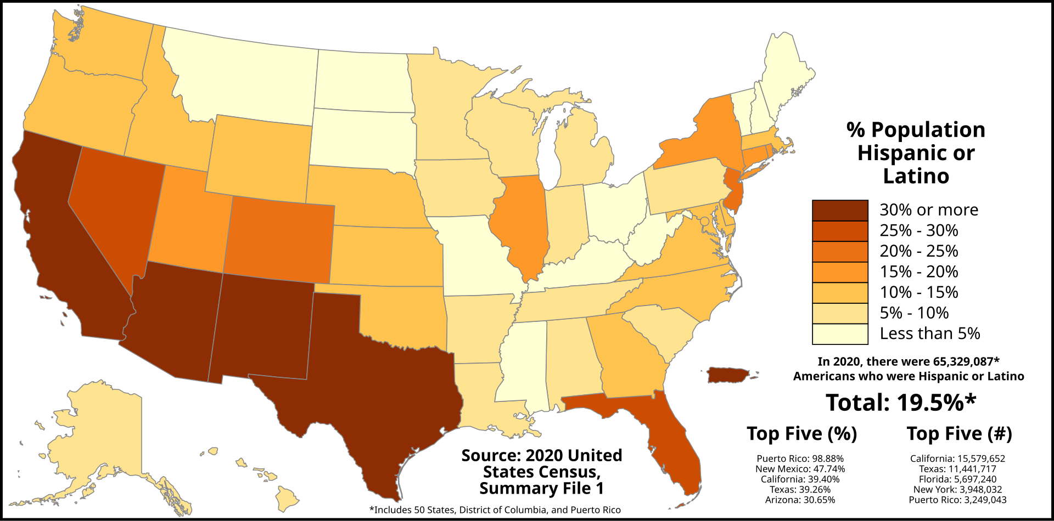
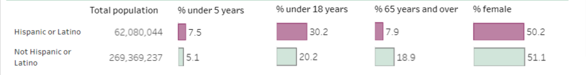
Demographics of U.S. Hispanic population
Image by Abbasi786786 - Own work, CC BY-SA 4.0, https://commons.wikimedia.org/w/index.php?curid=103516425
19.5% of the U.S. population

Slide 3
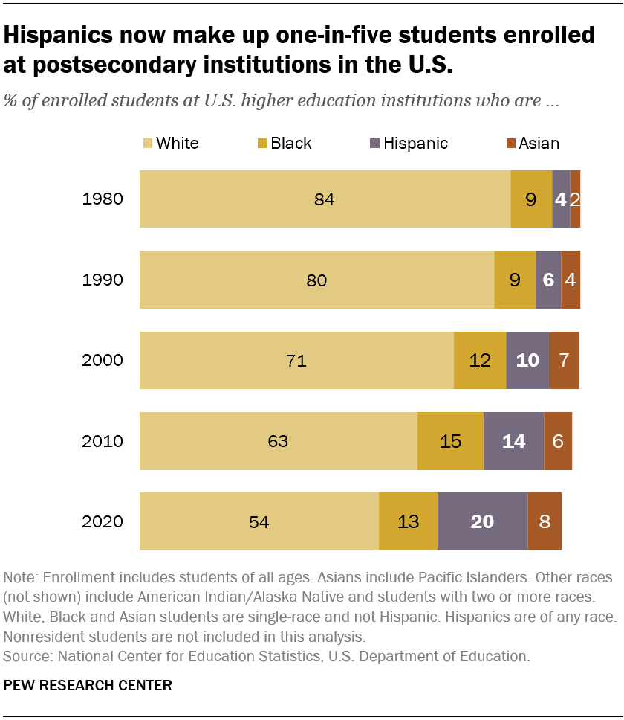
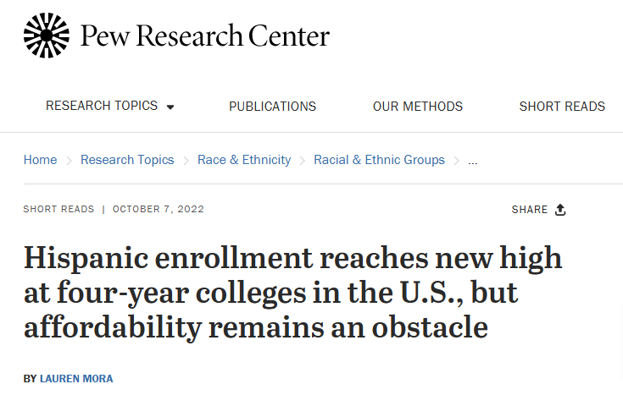
Hispanics and higher education
Good news:

Slide 4
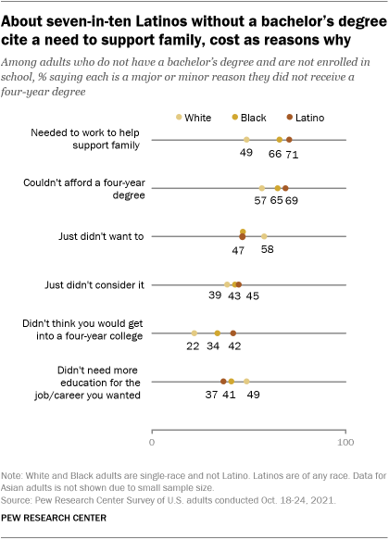
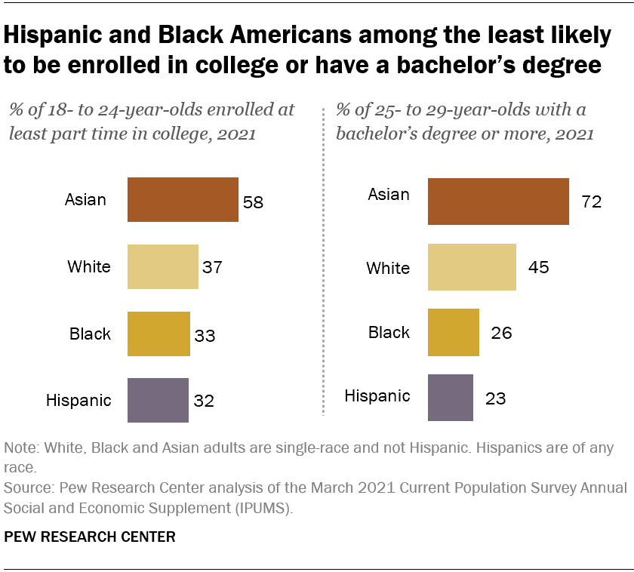
Hispanics and higher education
Bad news

Slide 5
Hispanics and higher education
Other reasons that have historically affected Latino students
Different forms of sociocultural capital than privileged in schools (specially for 1st generation) (Carter, 2005; Strayhorn, 2008).
Having to learn a “second curriculum” (the culture of higher education) (Fleming 1981);
Feeling marginalized, isolated, alienated, unsupported, and unwelcomed by other students and faculty (particularly at PWI) (Castellanos & Jones, 2003; Bennett & Okinaka, 1990; Smedley et al., 1993);
Limited English proficiency and negative stereotypes from faculty (Justiz & Rendón, 1989)
“Overall, a 62% majority of U.S. adults ages 25 and older do not have a bachelor’s degree, including about eight-in-ten Hispanics (79%).” (Pew Research Center)

Slide 6

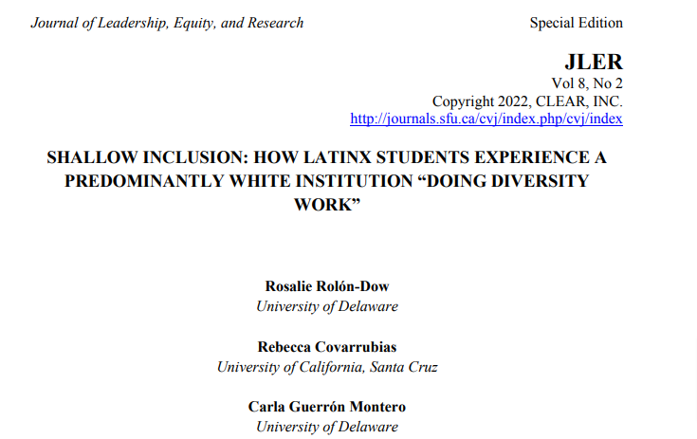
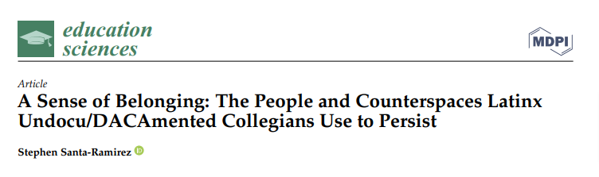
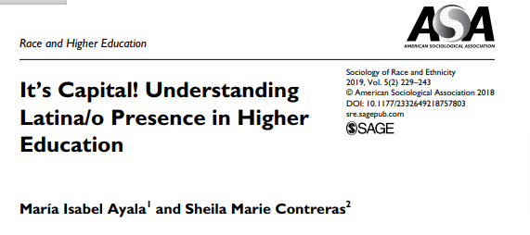
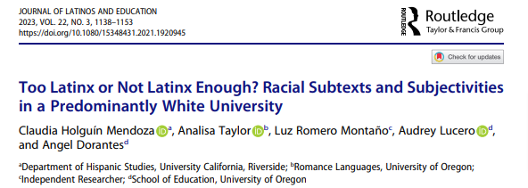
Hispanics and higher education

Slide 7
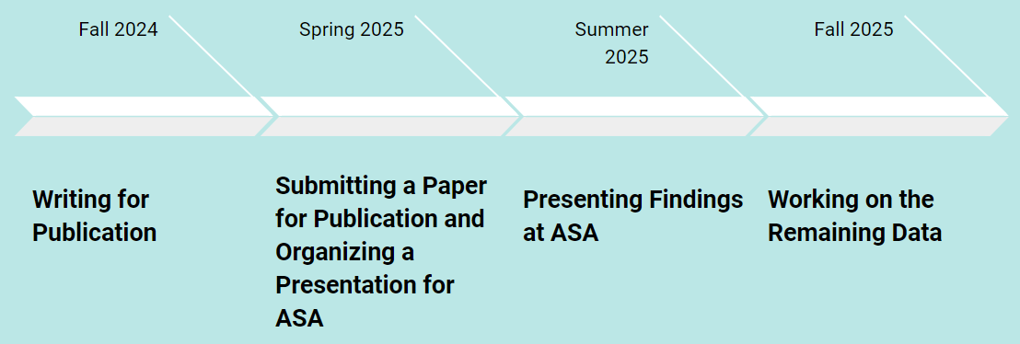
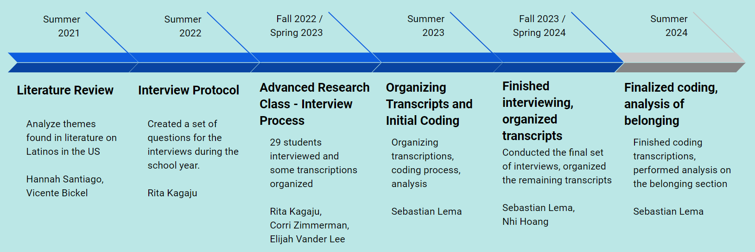
Study
Beyond Ethnicity Project: Perceptions of Racial Identity and Belonging to a PWI among Latina/o/e Students.

Slide 8
Research Question
How do the different aspects of the college experience impact the sense of belonging of Latina/o/e students at Hope College?
and
Are there significant differences between the three groups (F1, WI, NWI) when it comes to understanding sense of belonging?

Slide 9
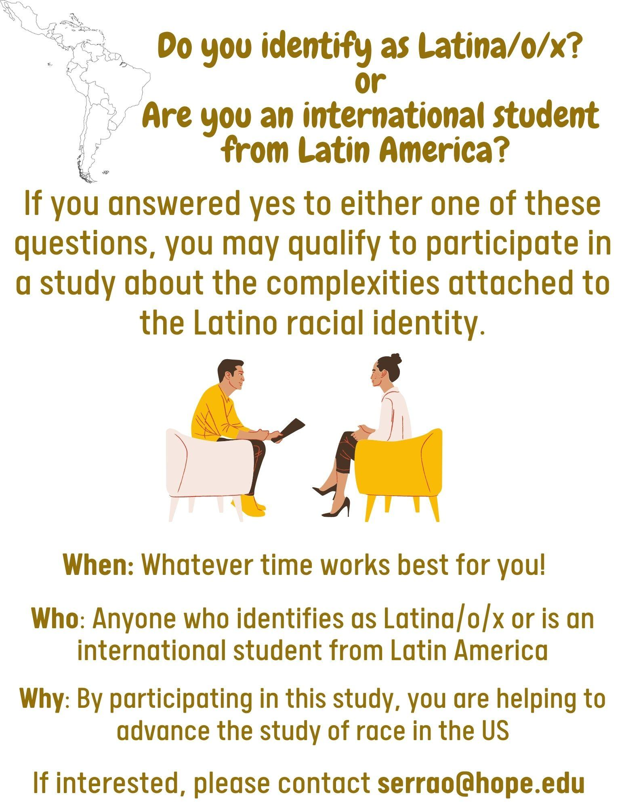
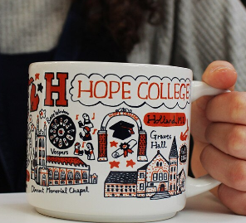

Methods
Interviews conducted
  55 total interviews (~20% of Latina/o/e students at Hope)
  20 WI, 20 NWI, 15 F1
Recruiting strategies
  Snowball sampling, flyers, emails, and incentives
Interviews:
  Basic Demographics (next slide) - Google Form
  Ranged from 1-2 hrs in length
  Conversations about
    Race and racism
    Colorism and mestizaje
    Perceptions of belonging to a PWI

Slide 10
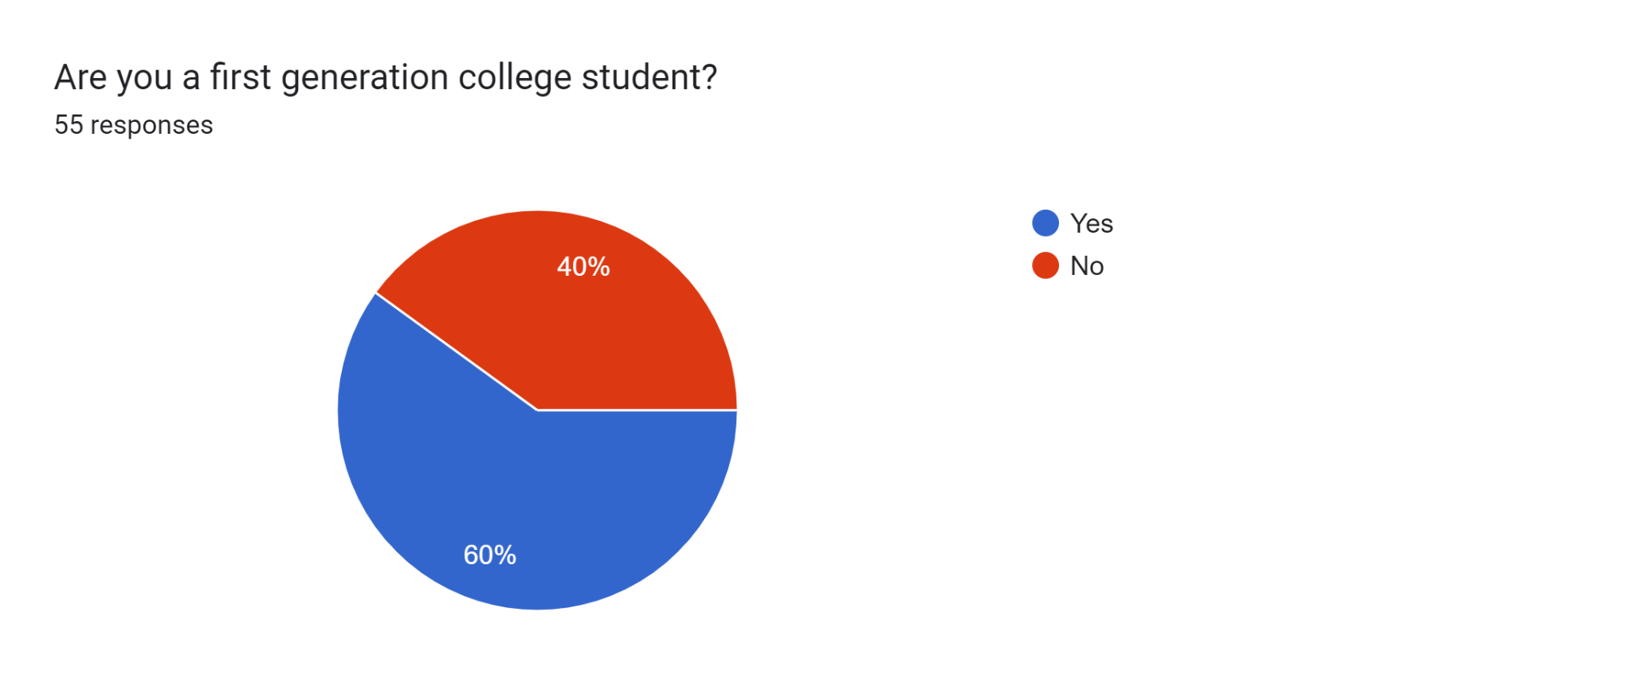
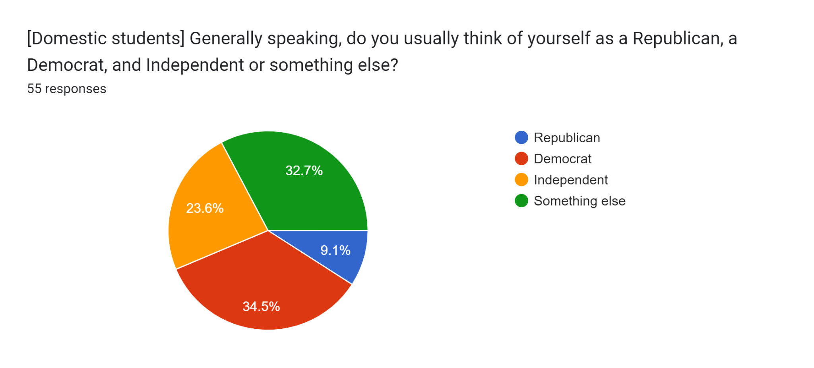
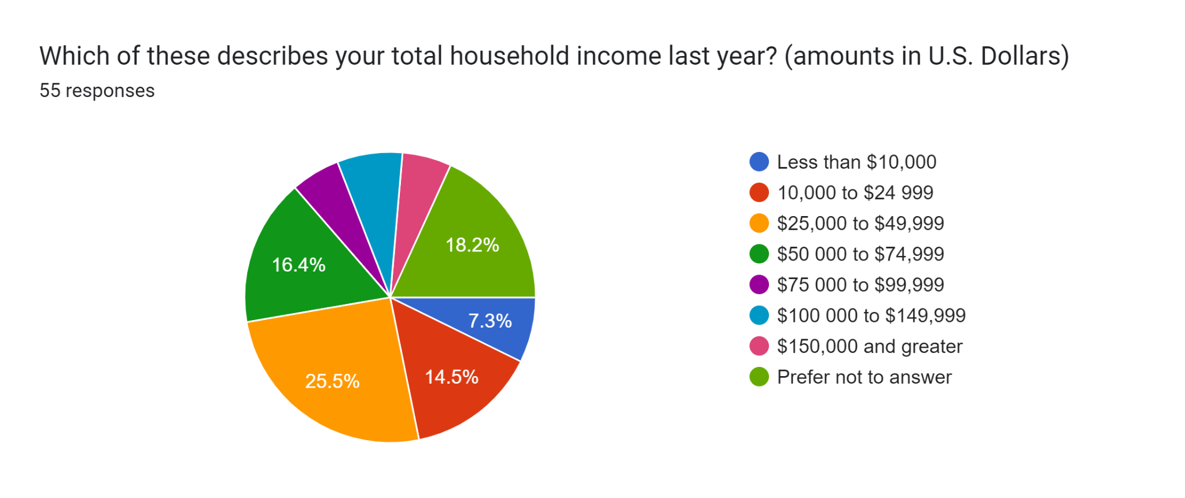
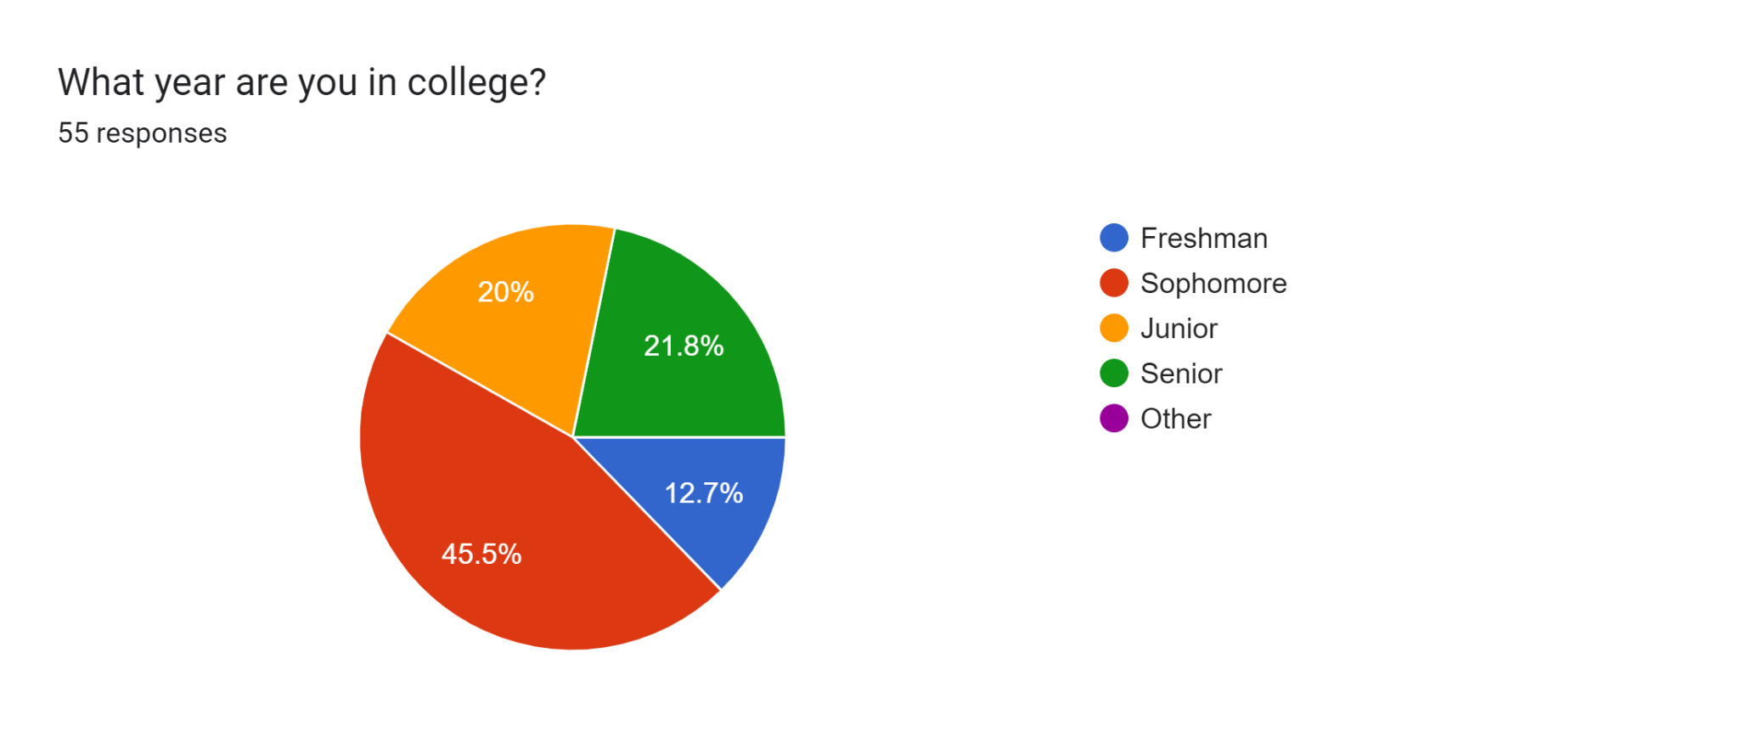
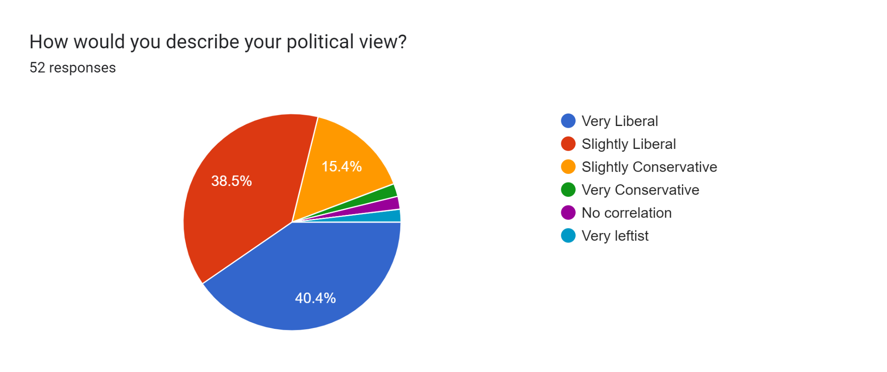
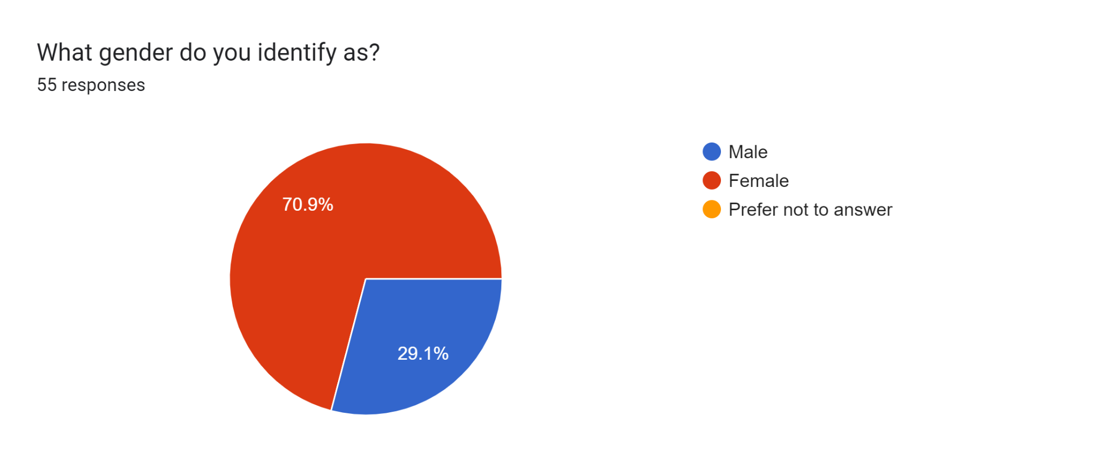
Demographics

Slide 11


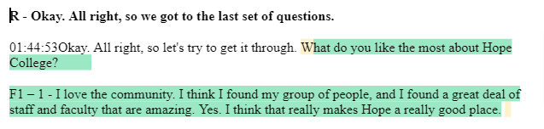
Data and Analysis
Transcript done via voice-to-text automated transcription services
Transcript organization (student researchers)
Dedoose Qualitative Research Software
  Used dedoose for data management, excerpting/coding, and analysis
  Line-by-line and paragraph-by-paragraph coding (Charmaz 2006; Flick 2014).
  Combined qualitative data with demographics data
Analysis:
  Focused on the section on belonging for continued analyses
  Using grounded theory to allow the data to guide theory (inductive approach)
  Five categories

Slide 12
Categories
Inclusion
  Sample Question: As a Latino/international student, do you feel welcome at Hope College? Do you feel included at Hope College? Explain.
Connections
  Sample Question: Where do you feel at home the most at Hope? Why?
Classroom Experiences
  Sample Question: Has your Latino identity affected your classroom experiences at Hope?
Assessment of the College
  Sample Question: What do you like the most (or the least) about Hope College?
Support Resources
  Sample Question:Where do you go to seek help at Hope College when you encounter stressful situations?

Slide 13
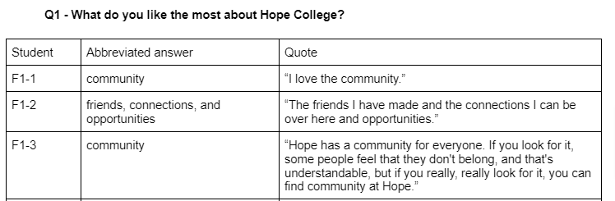
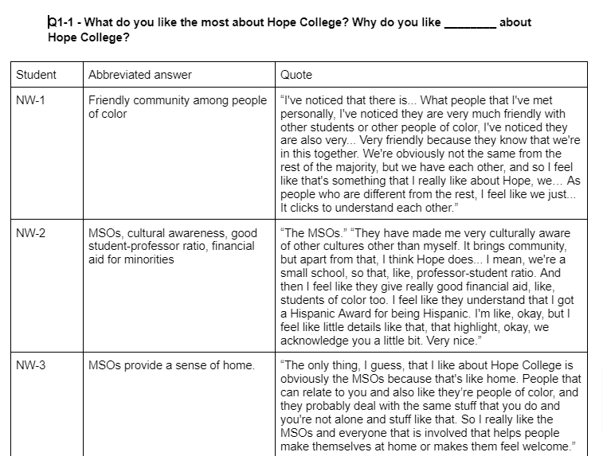
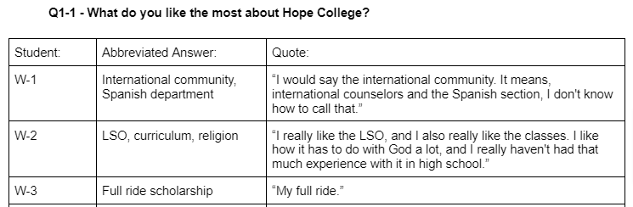
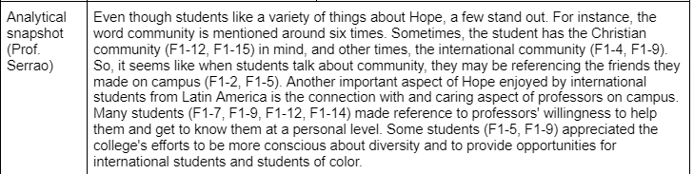
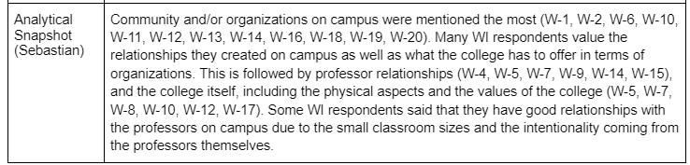
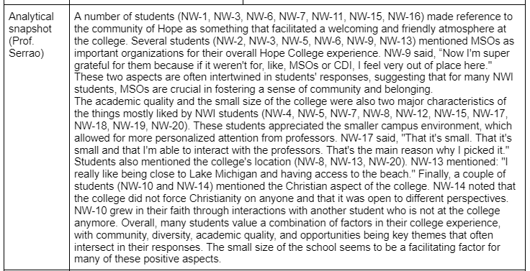
Analytical Snapshots
International students
White-identifying
Non-White identifying

Slide 14
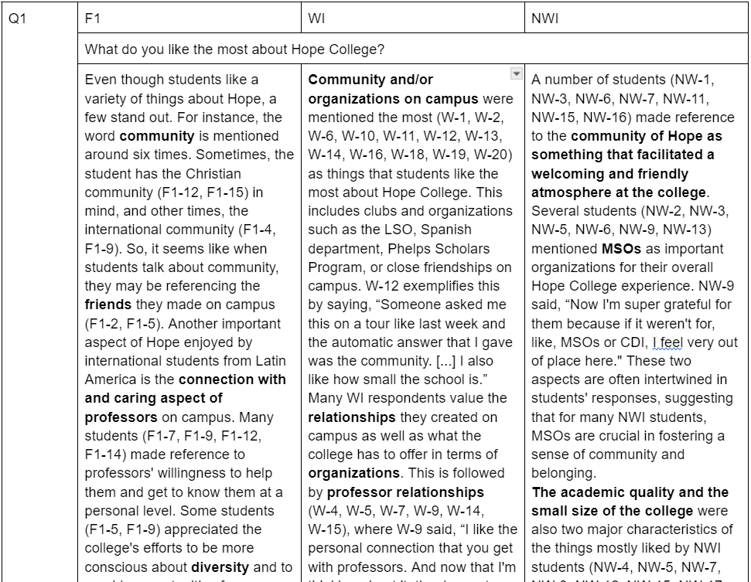
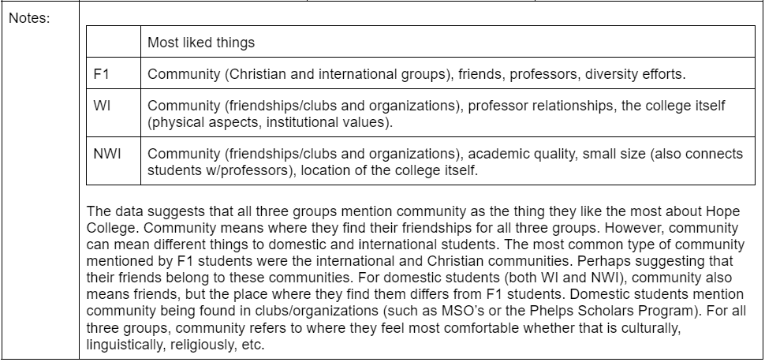
Synthesis of Snapshots

Slide 15
Categories
Classroom Experience
Support Resources
Assessment of the College
Connections
Inclusion
Has to do with friendships, organizations, places/spaces.
Has to do with inclusion, belonging, and feeling welcome.
Has to do with classroom experience.
Has to do with microaggressions and where to go.
Has to do with what is most cherished about the college.

Slide 16
Working Definition
“sense of belonging is relational” (Strayhorn)
Belonging
“A sense of belonging is defined as the subjective feeling of fitting in and being included as a valued and legitimate member in a particular setting…” (Lewis et al., 2017)
Group
“In terms of college, sense of belonging refers to students’ perceived social support on campus, a feeling or sensation of connectedness, the experience of mattering or feeling cared about, accepted, respected, valued by, and important to the group (e.g., campus community) or others on campus (e.g., faculty, peers)...” (Strayhorn, 2012, p.3, italics mine)
Support/satisfy
Care for / support
Individual

Slide 17
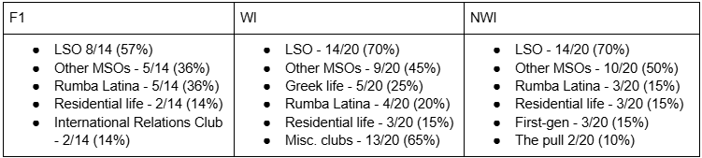
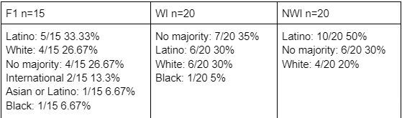
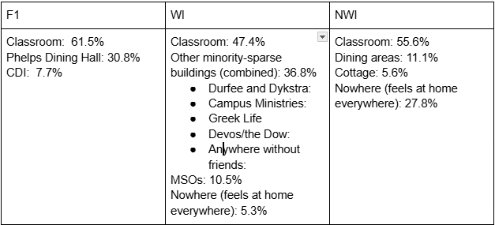
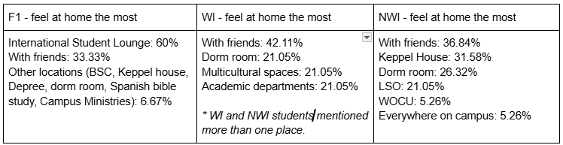
Connections
Involvement in clubs and organizations
Friendship pattern (majority)
Feel least at home
Feel most at home

Slide 18
Connections
“F1-4: My freshman year when I came to college, you do an international student orientation for a whole week before actual orientation. So when you come to Hope, you are welcomed by these awesome people. They're great. And you're like, on cloud nine, everything's pink and beautiful and rainbows, and then you're thrown into what actually Hope College is. So you get so thrown off by how different it is.”
Feel least at home
F1-9: “I would say... inside the classroom [...], it is the place where I have the most difficulty in feeling like I belong. Because of the language barrier…”
NW-1: “I feel like sometimes I don't belong here when in a classroom full of people who don't look like me. And I feel like I'm alone.”
W-7: In some of the classes that are not as diverse, I do feel a little out of place.”

Slide 19
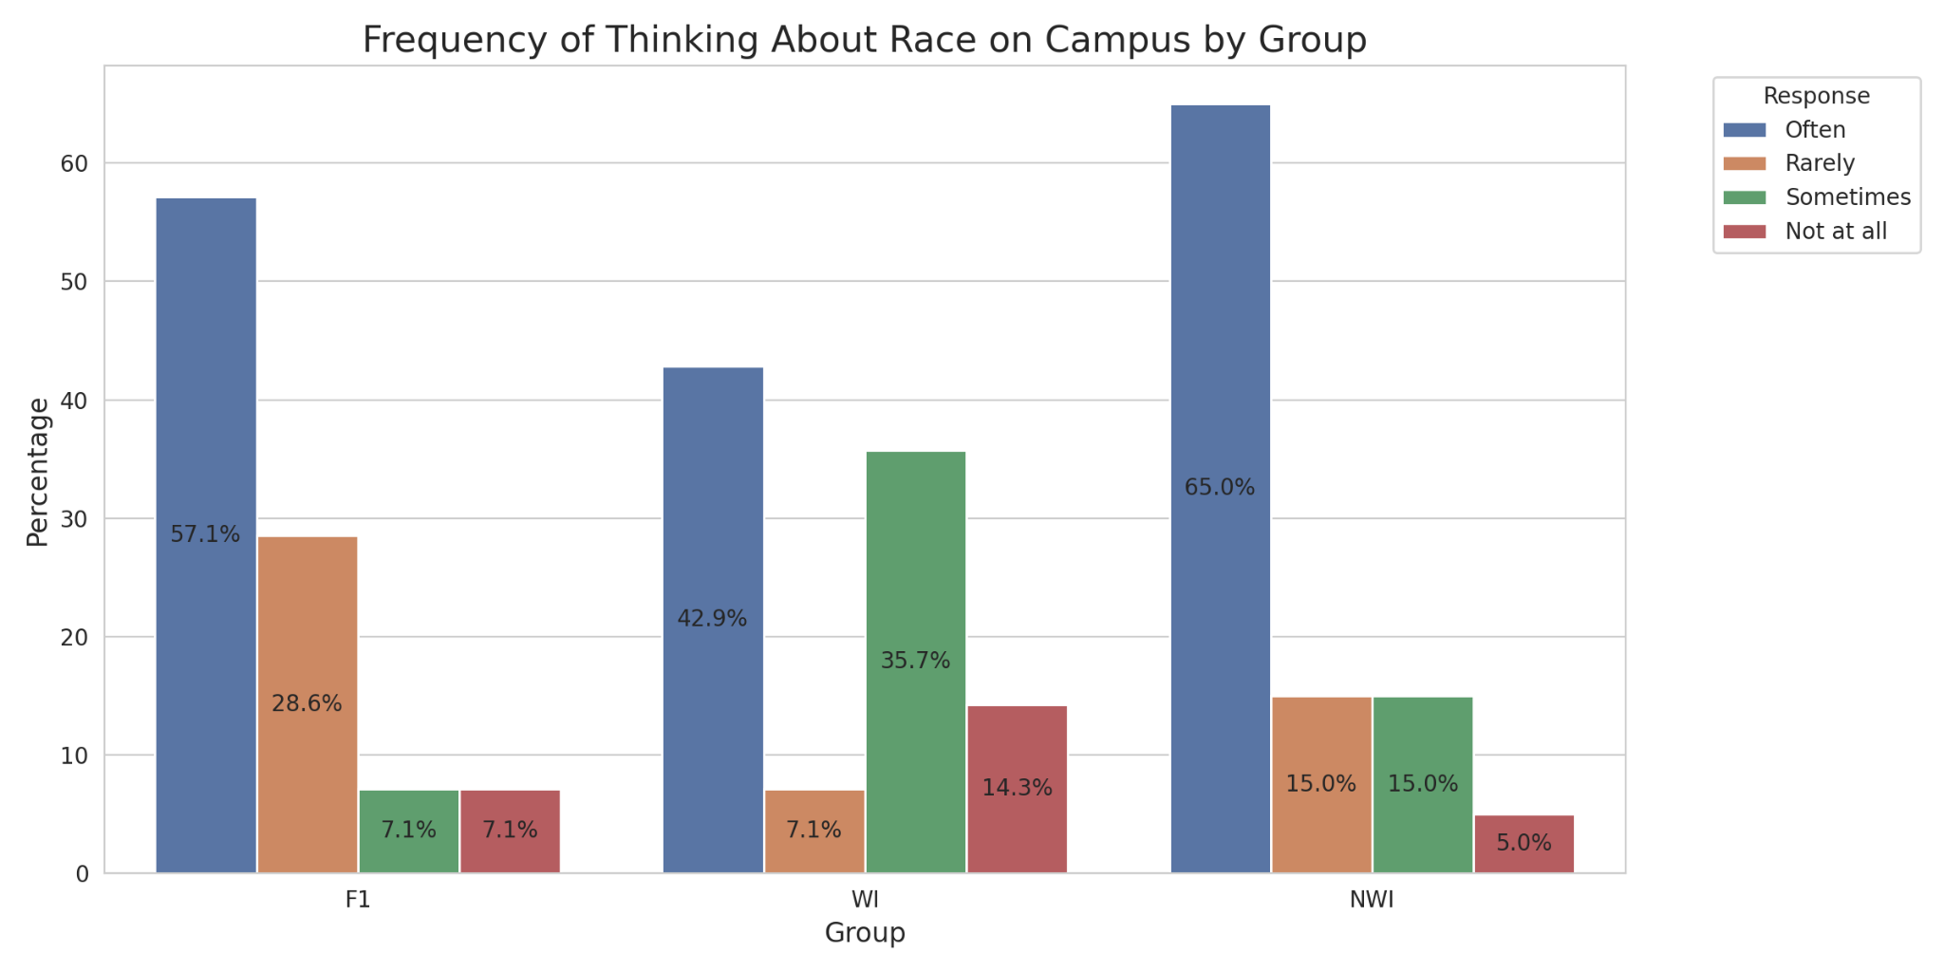
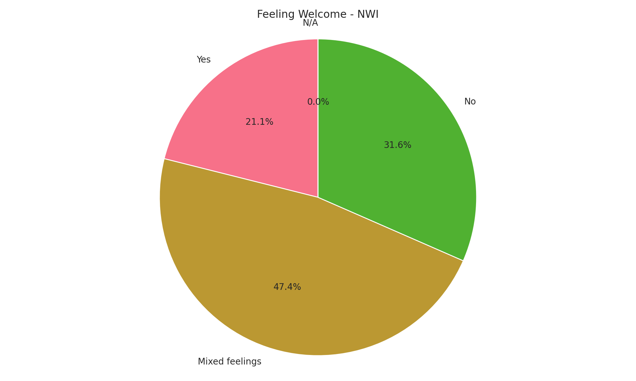
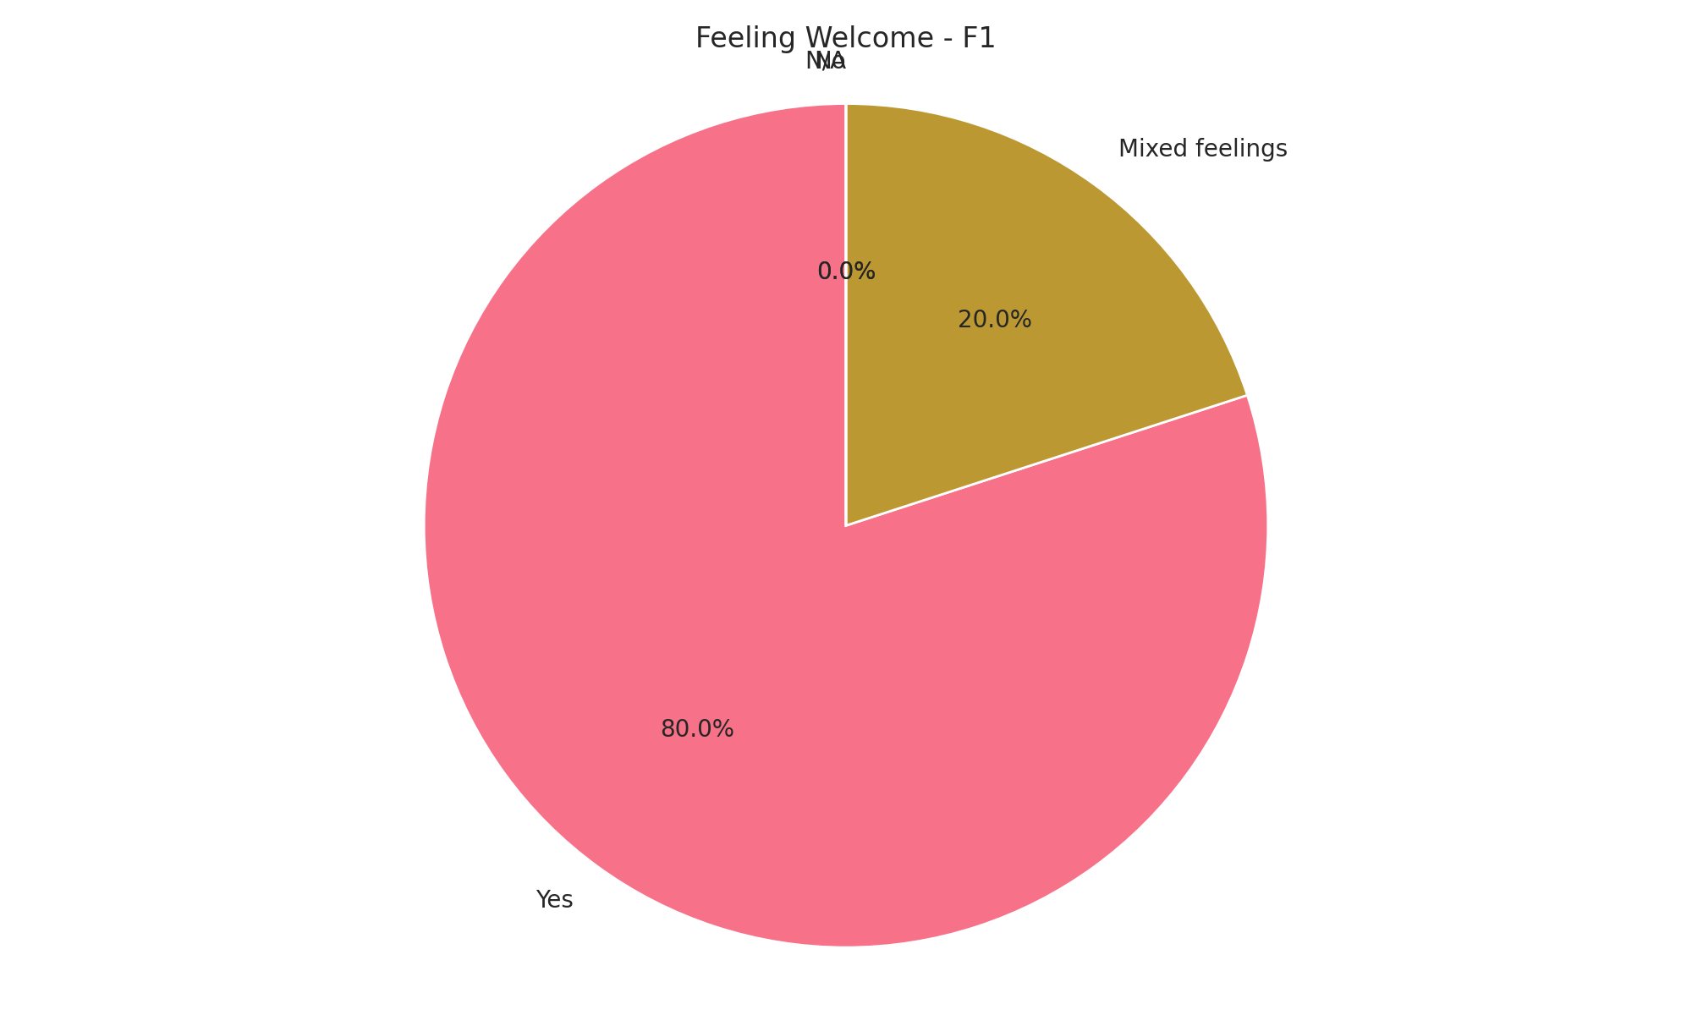
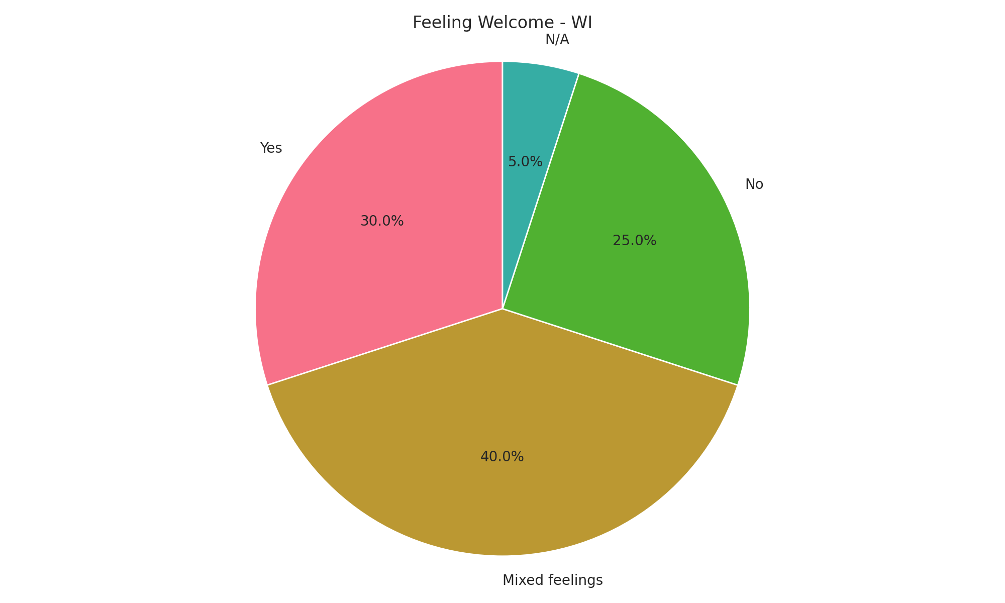
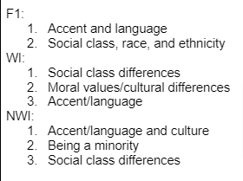
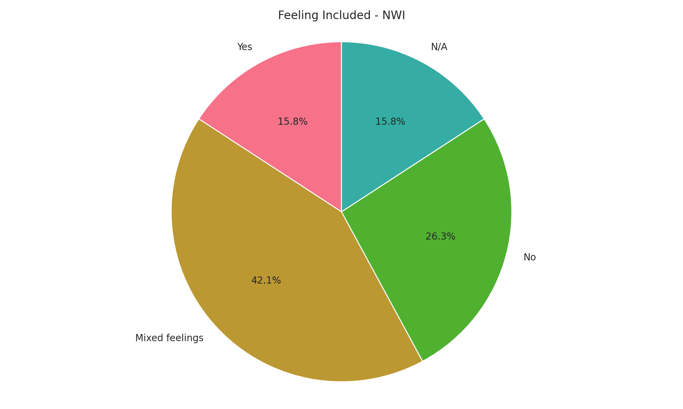
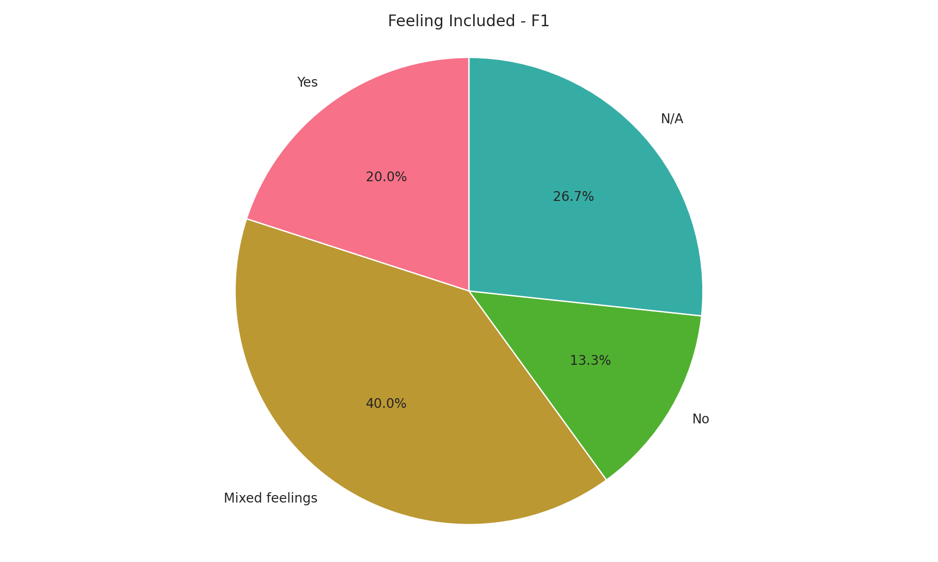
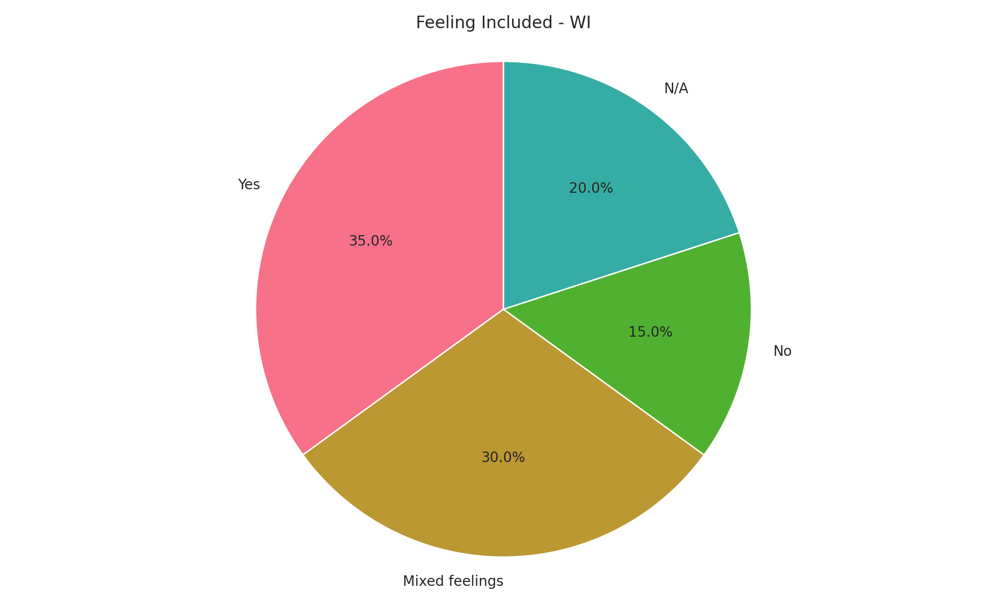
Inclusion
Thinking about race/ethnicity on campus
Feeling Welcomed and Included
Markers of difference
affecting interactions

Slide 20
Inclusion
Feeling Welcomed and Included
F1-2: At Hope, we have an international community, and they're very welcoming, and they're really united, so I would say by them, yes. [...] But Hope in general, I would say not so much.”
W-4: “I do feel included, but that's only because I include myself. [...] And it kind of sucks that you have to try, but I'm going to try. Like how I said before, that's just how I am and how I think I belong here.”
NW3: “The students here make it difficult. Like the white students make it so difficult sometimes.” “Yeah, I feel included by the MSOs again because they're the only ones that get it. But other than that other than that, no.”

Slide 21
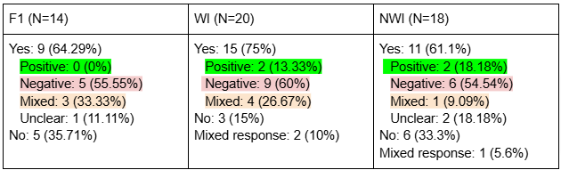
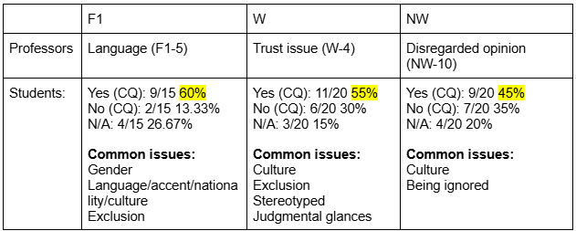
Classroom Experience
Latina/o/e identity affecting classroom experience
Competence questioned (CQ) through interactions with students or professors

Slide 22
Classroom Experience
Competence questioned (CQ) through interactions with students
W-19: “Absolutely. [...] Here's the thing: I'll be working in a lab group, right? And someone will just come out with, 'Oh, but you probably don't know how to do this.' And I'm thinking, ‘What the hell? Why wouldn't I know how to do this? Why is that your first assumption about me?’”
NW-8: Yeah, for sure. It's like this: I can suggest something, and they'll just ignore it. But if someone else says the exact same thing, suddenly it's a great idea. And I'm sitting there thinking, 'Why the hell didn't you listen to me?'
F1-5: “Yes, like people not taking into account what I'm saying, stuff like that. Yeah, like in my class, I had classmates who didn't want me to read or give feedback on their papers because it wasn't my first language.”

Slide 23
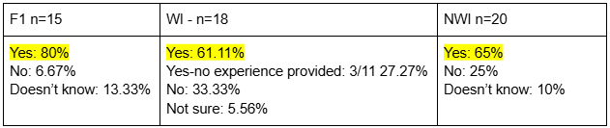
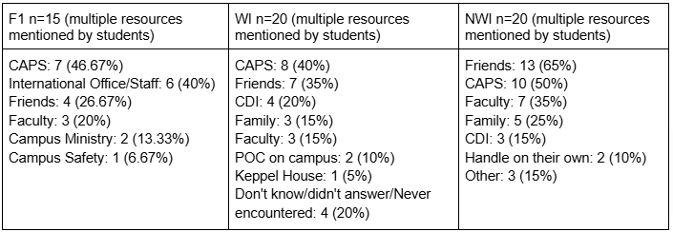
Support Resources
Where to go to cope with feelings of being targeted or discriminated against
Experienced microaggression at Hope
W-6: “Dykstra. [...] It's been hard having all these microaggressions because it's basically a bunch of white girls, upper class white girls who live there who say things and don't realize.”
W-2: “I would definitely talk about it with some of my friends”
NWI-5: “In my freshman year, my roommate just grabbed [my sombrero that was hanging in the wall] and put it in my closet. Or like, saying comments like, dang, wait, you’re Mexican and you’re doing math and physics? That's impressive!”
NW-10: “I know I can go to CAPS if I'm emotionally distressed. And if I just have something on my mind, there's my Friends.”
F1-3: “A lot of microaggressive comments. [...] My roommate, for example, when I would come to her with things that were bothering me [about] things that were happening at home, she would just ignore me or be like, ‘Oh, but it's fine because it's a third world country,’ or things like that. Like comments like that that would build up over time [and] make me very mad...”
F1-7: “I will first go to the international advisors at the Global Engagement. They're like the first ones that comes up to my mind…”

Slide 24
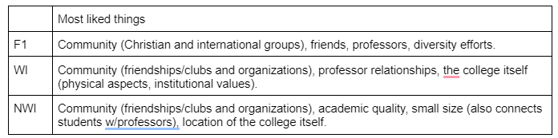
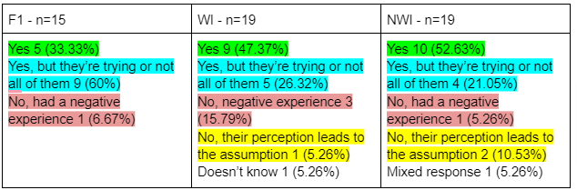
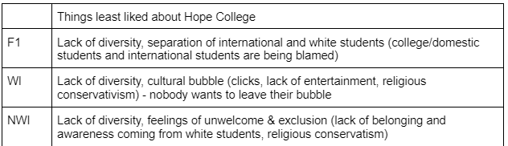
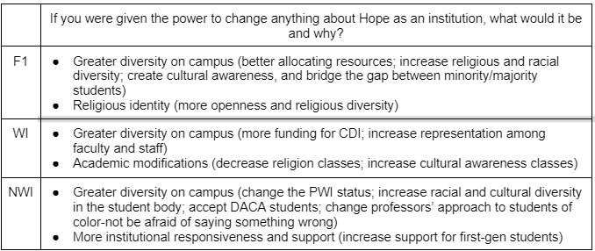
Assessment of the College
Are faculty and staff culturally sensitive and aware?
Most liked things about Hope
Least liked things about Hope
What would you change about Hope?

Slide 25
Hope College Retention (2012-2022)
Racial Group | Retained (N) % |  | Not Retained (N) %
Asian | (163) 87.6% |  | (23) 12.4%
Black or African American | (232) 88.2% |  | (31) 11.8%
Hispanic | (635) 84% |  | (121) 16%
Two or More Races | (226) 82.8% |  | (47) 17.2%
White | (6595) 90.4% |  | (699) 9.6%
Unknown | 67) 95.7% |  | (3) 4.3%
Data: Frost Center For Data and Research
Notes:
I want to mention that these non-retention rates are not an indicative that these students have left higher education for good. This data don’t say where these students went after they left Hope.

Slide 26
Hope College Retention (2012-2022)
Racial Group | Retained (N) % |  | Not Retained (N) %
Asian | (163) 87.6% |  | (23) 12.4%
Black or African American | (232) 88.2% |  | (31) 11.8%
Hispanic | (635) 84% |  | (121) 16%
Two or More Races | (226) 82.8% |  | (47) 17.2%
White | (6595) 90.4% |  | (699) 9.6%
Unknown | 67) 95.7% |  | (3) 4.3%
Data: Frost Center For Data and Research
Notes:
I want to mention that these non-retention rates are not an indicative that these students have left higher education for good. This data don’t say where these students went after they left Hope.

Slide 27
Thank You!
Frost Center, Provost’s Office, Sociology Department
Vicente Beckel, Nhi Hoang, Rita Kagaju, Elijah Vander Lee, Sebastian Lema, Hannah Santiago, Corri Zimmerman, and all Latina/o/e students who participated

